Slide 1
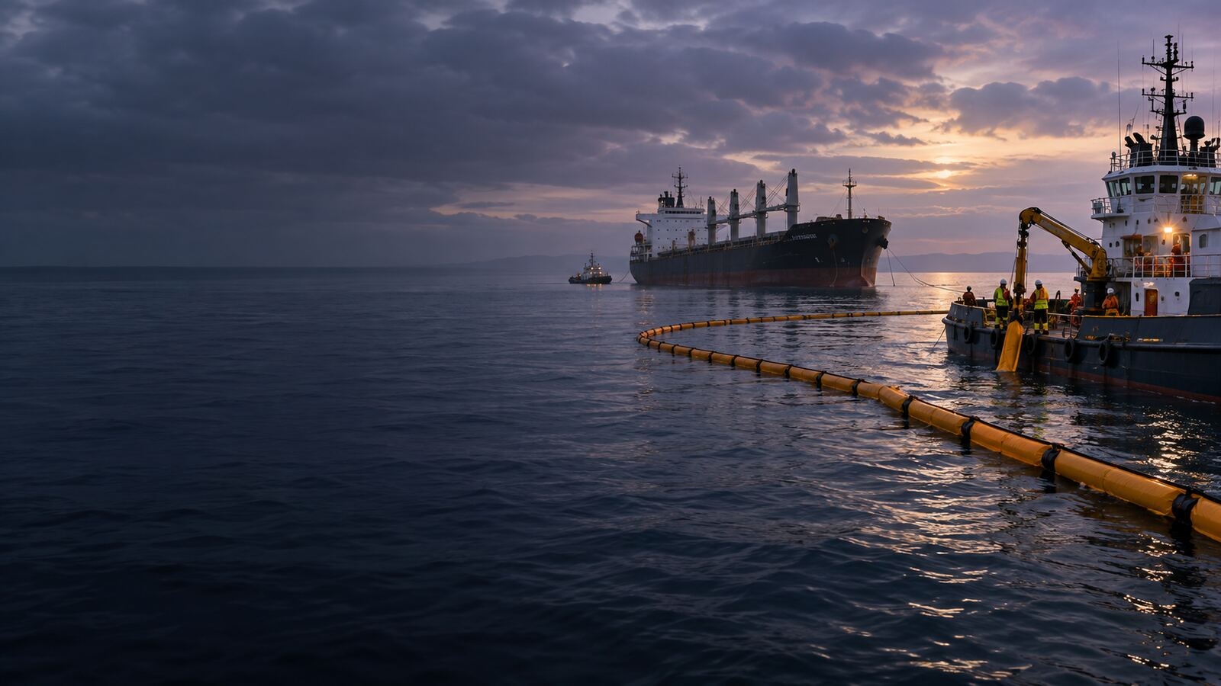

LONDON GATEWAY COLLEGE
LECTURE 1
Compensation for Pollution Damage from Seabed Mineral Exploration and Extraction
Oil Pollution and Compensation Law
Course Code LGC300
Notes:
Source: London Gateway College supplied course material, Oil Pollution and Compensation Law (LGC300). LECTURE 1. Educational use only.

Slide 2
LONDON GATEWAY COLLEGE
LGC300
Learning focus
• Explain the principal concepts associated with compensation for pollution damage from seabed mineral exploration and extraction.
• Apply the lecture principles to a realistic professional situation.
• Identify the evidence, authority and judgement required for a defensible conclusion.
• Introduction
• Legal Framework and the Role of OPOL
• Limitations of OPOL and Compensation Concerns
Oil Pollution and Compensation Law 02
Notes:
Source: London Gateway College supplied course material, Oil Pollution and Compensation Law (LGC300). Learning focus. Educational use only.

Slide 3
LONDON GATEWAY COLLEGE
LGC300
Introduction
• With advancements in technology, the offshore industry has intensified efforts to explore and extract seabed mineral resources in deeper waters.
• This expansion has led to an increase in operational fields.
• Due in part to strict regulations imposed by coastal states, the industry has maintained a strong safety record.
• Until recently, offshore installations were regarded as minor contributors to marine pollution compared to other sources.
Oil Pollution and Compensation Law 03
Notes:
Source: London Gateway College supplied course material, Oil Pollution and Compensation Law (LGC300). Introduction. Educational use only.

Slide 4
LONDON GATEWAY COLLEGE
LGC300
Legal Framework and the Role of OPOL
• In the UK, operators cannot obtain offshore licenses without participating in the Offshore Pollution Liability Agreement (OPOL).
• Established in 1975 as a voluntary contractual arrangement among major oil companies, OPOL was initially intended as an interim measure pending the adoption of an international liability framework.
• The 1977 Convention on Civil Liability for Oil Pollution Damage from Seabed Mineral Exploration and Exploitation (CLEE) sought to provide a comprehensive legal standard but failed to gain sufficient ratification to take effect.
• As a result, OPOL remains the primary mechanism for addressing offshore pollution liability and now extends to offshore facilities in several European countries, including Denmark, Germany, France, Ireland, and Norway.
Oil Pollution and Compensation Law 04
Notes:
Source: London Gateway College supplied course material, Oil Pollution and Compensation Law (LGC300). Legal Framework and the Role of OPOL. Educational use only.

Slide 5
LONDON GATEWAY COLLEGE
LGC300
Limitations of OPOL and Compensation Concerns
• While OPOL provides a structured claims mechanism, its financial limitations may prove insufficient in the case of a large-scale disaster.
• The Deepwater Horizon incident, for example, resulted in costs reaching billions of dollars, far exceeding OPOL’s $250 million cap.
• Additionally, the scope of recoverable claims under OPOL remains ambiguous.
• Compensation is restricted to pollution-related losses with a direct causal link to contamination, raising concerns about the eligibility of economic losses suffered by businesses indirectly affected, such as hotels and fisheries.
Oil Pollution and Compensation Law 05
Notes:
Source: London Gateway College supplied course material, Oil Pollution and Compensation Law (LGC300). Limitations of OPOL and Compensation Concerns. Educational use only.

Slide 6
LONDON GATEWAY COLLEGE
LGC300
National and International Legal Challenges
• As a voluntary agreement, OPOL lacks formal legal standing beyond contractual obligations among participating operators.
• Although the UK mandates OPOL participation for offshore licensing, claimants may still seek compensation through national courts by bypassing OPOL and directly suing operators or subcontractors, particularly in cases of.
• Such lawsuits would require demonstrating that the operator failed to take reasonable preventive measures, leading courts to assess whether existing national or international laws apply.
• One key legal question is whether offshore platforms fall under existing maritime liability conventions.
Oil Pollution and Compensation Law 06
Notes:
Source: London Gateway College supplied course material, Oil Pollution and Compensation Law (LGC300). National and International Legal Challenges. Educational use only.

Slide 7
LONDON GATEWAY COLLEGE
LGC300
DEFINITION OF “SHIP” IN SCOTLAND FOR ARREST PURPOSES
• In Scotland, the term "ship" for the purpose of arrest is defined under Section 48 of the Administration of Justice Act 1956.
• This definition aligns with Section 313 of the Merchant Shipping Act (MSA) 1995, outlining that a ship includes "any description of vessel used in navigation not propelled by oars." Examining extensive case law on the.
• Similar interpretations have been upheld in both Canadian and American courts.
• For instance, in Bow Valley Husky (Bermuda) Ltd v.
Oil Pollution and Compensation Law 07
Notes:
Source: London Gateway College supplied course material, Oil Pollution and Compensation Law (LGC300). DEFINITION OF “SHIP” IN SCOTLAND FOR ARREST PURPOSES. Educational use only.

Slide 8
LONDON GATEWAY COLLEGE
LGC300
RECOVERABILITY OF PURE ECONOMIC LOSS
• Under English law, claimants seeking compensation for economic losses due to pollution may not necessarily benefit from pursuing tort claims against operators.
• British courts have historically been reluctant to award damages for pure economic loss in negligence cases, unlike some other common law jurisdictions.
• Although exceptions exist, such as under the Nuclear Installations Act 1965, a shift in the judiciary’s stance on this matter is unlikely in the near future.
• An alternative legal avenue is a public nuisance claim, provided the claimant meets specific criteria.
Oil Pollution and Compensation Law 08
Notes:
Source: London Gateway College supplied course material, Oil Pollution and Compensation Law (LGC300). RECOVERABILITY OF PURE ECONOMIC LOSS. Educational use only.

Slide 9
LONDON GATEWAY COLLEGE
LGC300
Applied activity
• Review a fictional or public scenario involving compensation for pollution damage from seabed mineral exploration and extraction.
• Identify the material facts, unresolved assumptions and governing principles.
• Prepare an issue and evidence matrix before reaching a conclusion.
• Recommend practical action and explain any point requiring specialist advice.
Oil Pollution and Compensation Law 09
Notes:
Source: London Gateway College supplied course material, Oil Pollution and Compensation Law (LGC300). Applied activity. Educational use only.

Slide 10
LONDON GATEWAY COLLEGE
LGC300
Knowledge check
• What is the central principle examined in compensation for pollution damage from seabed mineral exploration and extraction?
• Which facts would materially change the analysis?
• Which source provides the strongest authority for your conclusion?
• What evidence should a professional obtain first?
• Which risk, remedy or control should receive priority, and why?
Oil Pollution and Compensation Law 10
Notes:
Source: London Gateway College supplied course material, Oil Pollution and Compensation Law (LGC300). Knowledge check. Educational use only.

Slide 11
LONDON GATEWAY COLLEGE
LGC300
Independent research task
• Consult at least two authoritative sources listed in the lecture learning guide.
• Prepare a 900 to 1,100 word professional response and a one-page issue or evidence matrix.
• Cite every external source and record the date accessed.
• Upload the final work, source list and originality declaration to the LMS.
Oil Pollution and Compensation Law 11
Notes:
Source: London Gateway College supplied course material, Oil Pollution and Compensation Law (LGC300). Independent research task. Educational use only.

Slide 12
LONDON GATEWAY COLLEGE
LGC300
Lecture summary
• Introduction
• Legal Framework and the Role of OPOL
• Limitations of OPOL and Compensation Concerns
• National and International Legal Challenges
• DEFINITION OF “SHIP” IN SCOTLAND FOR ARREST PURPOSES
Oil Pollution and Compensation Law 12
Notes:
Source: London Gateway College supplied course material, Oil Pollution and Compensation Law (LGC300). Lecture summary. Educational use only.

Slide 13
LONDON GATEWAY COLLEGE
LGC300
Recommended sources
• IMO Civil Liability Convention
• IMO Fund Convention
• International Oil Pollution Compensation Funds
• IMO MARPOL Convention
• London Gateway College Oil Pollution and Compensation Law course material
Oil Pollution and Compensation Law 13
Notes:
Source: London Gateway College supplied course material, Oil Pollution and Compensation Law (LGC300). Recommended sources. Educational use only.

