Slide 1
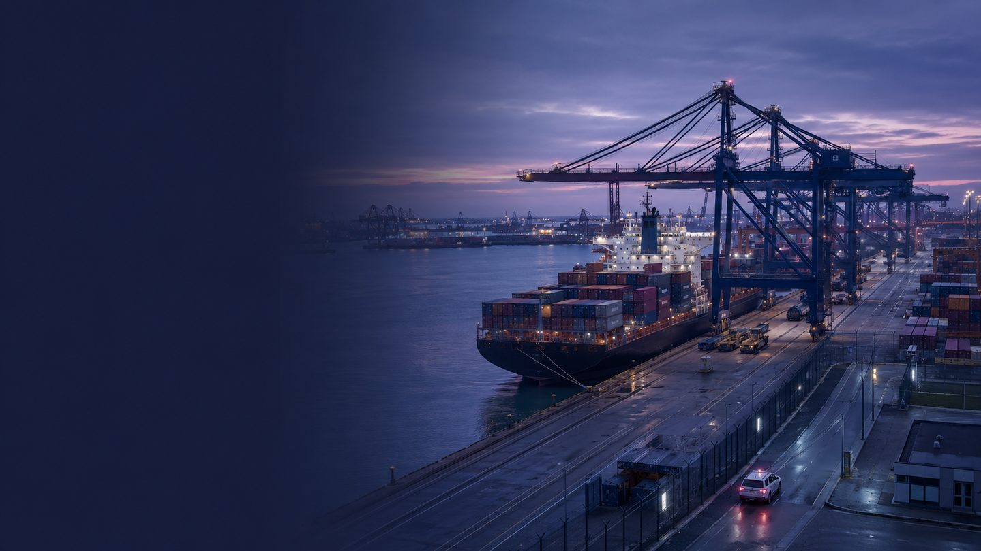

LONDON GATEWAY COLLEGE
PORT SECURITY
MANAGEMENT
Course code: PSM-28
LECTURE 1
Introduction to Port Security Management
Comprehensive learning aid • CPD training deck
Notes:
Open by establishing that port security protects people, trade, vessels and critical infrastructure. Invite learners to name one security concern they associate with a modern port.
[Sources]
- London Gateway College, Port Security Management course source, Lecture 1.
- Cover image: AI-generated for this deck; no external asset source.
[/Sources]

Slide 2
PORT SECURITY MANAGEMENT • PSM-28 • LECTURE 1
Course aim
Develop confident, risk-aware port security practitioners
LEARNERS WILL
The course provides a comprehensive understanding of the principles, practices and regulatory frameworks that underpin security in the global maritime industry.
Identify
Assess
Manage
security risks in port environments
People • Cargo • Vessels • Infrastructure • Trade
Professional emphasis: proactive risk management, emergency preparedness, compliance, technology, collaboration and ethical practice.
02
Notes:
Relate the course aim to learners' roles. Emphasise that effective security is both protective and enabling: it supports safe, resilient trade.
[Sources]
- London Gateway College, Port Security Management course source, Aim of the Course.
[/Sources]

Slide 3
PORT SECURITY MANAGEMENT • PSM-28 • LECTURE 1
Course learning outcomes — foundations
On successful completion, learners will be able to:
01
Explain core port-security concepts and strategic importance
02
Critically assess legal and regulatory frameworks, including SOLAS and the ISPS Code
03
Identify physical, cyber, criminal and insider threats
04
Develop security plans covering assessment, access, surveillance, response and communication
05
Explain stakeholder roles across port authorities, security, customs and international agencies
03
Notes:
Use the outcomes as a contract with learners: the deck introduces the first outcome and supports later outcomes through examples and activities.
[Sources]
- London Gateway College, Port Security Management course source, Learning Outcomes 1–5.
[/Sources]

Slide 4
PORT SECURITY MANAGEMENT • PSM-28 • LECTURE 1
Course learning outcomes — application
Learners will also be able to:
06
Apply risk-management principles to vulnerability assessment and mitigation
07
Analyse security technologies such as CCTV, biometrics, AIS and cyber tools
08
Evaluate incidents and turn lessons learned into stronger controls
09
Communicate during crises, inter-agency coordination and stakeholder reporting
10
Act ethically and lawfully while protecting rights and civil liberties
04
Notes:
Stress that competence is demonstrated through application and judgement, not memorisation alone. Point out the ethical and legal outcome as a cross-cutting requirement.
[Sources]
- London Gateway College, Port Security Management course source, Learning Outcomes 6–10.
[/Sources]

Slide 5
PORT SECURITY MANAGEMENT • PSM-28 • LECTURE 1
Lecture 1: learning objectives
01
Introduction to Port Security Management
A practical foundation for understanding threats, policy, partnerships and strategic security.
Explain why modern ports require integrated security management
Recognise major threats to shipping and global commerce
Describe the role of public policy and industry partnership
Connect security culture, access control and strategic resilience
05
Notes:
Preview the lecture and make the objectives measurable. Ask learners which objective is most relevant to their current role.
[Sources]
- London Gateway College, Port Security Management course source, Lecture 1 headings and objectives.
[/Sources]

Slide 6
PORT SECURITY MANAGEMENT • PSM-28 • LECTURE 1
Why ports require integrated security
A port is not a single site. It is a connected operational system.
1
2
3
4
PEOPLE
MOVEMENT
ASSETS
COMMERCE
Workers, passengers, visitors and communities
Vessels, vehicles, cargo and data flows
Berths, terminals, energy and communications
Time-critical supply chains and reputation
Security failure can cascade across safety, operations, trade, public confidence and national resilience.
06
Notes:
Use a systems perspective. Invite examples of how one access-control failure could affect several of the four protected domains.
[Sources]
- London Gateway College, Port Security Management course source, section 1.1.
[/Sources]

Slide 7
PORT SECURITY MANAGEMENT • PSM-28 • LECTURE 1
The post-2001 shift in maritime security
Security moved from a specialist concern to a core management responsibility.
BEFORE 2001
2001
2002–2004
TODAY
Fragmented oversight
Crime-led focus
Terror attacks expose transport vulnerability
SOLAS XI-2 and ISPS Code create a global framework
Risk-based, layered and collaborative security
Management implication: security must be designed into routine operations—not added after an incident.
07
Notes:
Clarify that 9/11 was a decisive catalyst, not the beginning of maritime crime. Link the regulatory response to SOLAS chapter XI-2 and the ISPS Code.
[Sources]
- London Gateway College, Port Security Management course source, sections 1.1 and 1.6.
- IMO, SOLAS XI-2 and the ISPS Code: https://www.imo.org/en/ourwork/security/pages/solas-xi-2%20isps%20code.aspx
[/Sources]

Slide 8
PORT SECURITY MANAGEMENT • PSM-28 • LECTURE 1
Port security management: three connected pillars
1
2
3
ORGANISE
UNDERSTAND
CONTROL
Governance, roles, leadership and stakeholder coordination
Threat, risk and vulnerability assessment
Plans, people, access, technology and incident response
The Port Facility Security Plan turns these pillars into assigned, auditable action.
08
Notes:
Explain that none of the pillars works alone. A technically strong control can still fail if responsibilities are unclear or risks are misunderstood.
[Sources]
- London Gateway College, Port Security Management course source, section 1.2.
[/Sources]

Slide 9
PORT SECURITY MANAGEMENT • PSM-28 • LECTURE 1
Building a culture of security
Culture is what people do when the security manager is not watching.
LEAD
Set expectations and model compliant behaviour
SECURITY
IS EVERYONE’S
RESPONSIBILITY
ENABLE
Train, equip and empower people to act
REPORT
Make concerns easy and safe to raise
LEARN
Review events, drills and near misses
09
Notes:
Ask for one observable behaviour that demonstrates security culture. Reinforce that reporting systems must support learning, accountability and fair treatment.
[Sources]
- London Gateway College, Port Security Management course source, section 1.3.
[/Sources]

Slide 10
PORT SECURITY MANAGEMENT • PSM-28 • LECTURE 1
Learner activity: see it, say it, support it
A familiar contractor holds a secure door open for an unbadged colleague who says their credential is in the vehicle.
1
2
3
4
What is the immediate risk?
What action should you take?
How should the event be reported?
What could prevent recurrence?
Apply local procedures. Do not trade access control for convenience or familiarity.
10
Notes:
Give learners two minutes to discuss. Expected themes: challenge safely, prevent tailgating, verify identity, notify the correct control point, record the event and address process or training gaps.
[Sources]
- Scenario developed from London Gateway College course source, sections 1.3 and 1.6.
[/Sources]

Slide 11
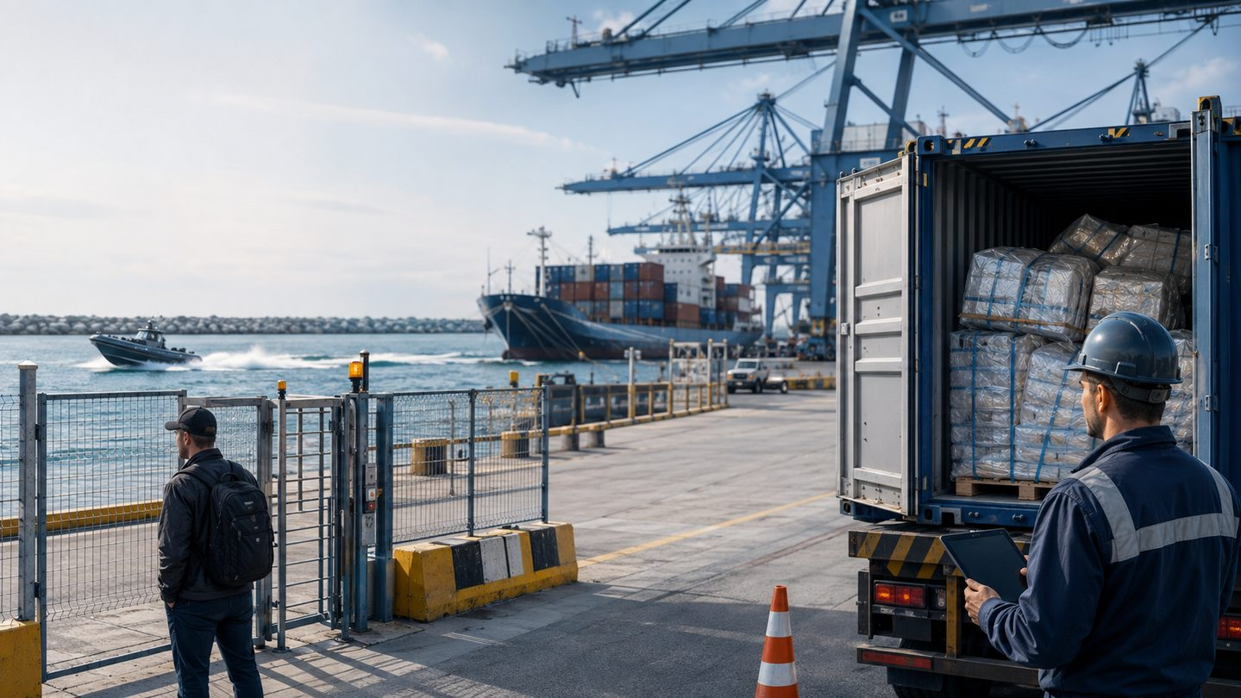
Threats exploit interfaces
Waterside • Landside • Cargo • People • Information
• Piracy & armed robbery
• Terrorism
• Smuggling & theft
• Insider activity
• Fraud & cyber compromise
Notes:
Use the image to practise observation. Ask learners to identify three interfaces and distinguish a threat from a vulnerability. Avoid discussing sensitive local details.
[Sources]
- London Gateway College, Port Security Management course source, section 1.4.
- Image: AI-generated for this deck; no external asset source.
[/Sources]

Slide 12
PORT SECURITY MANAGEMENT • PSM-28 • LECTURE 1
Piracy: read historical data with care
The source lecture records a sharp fall in reported global attacks between 2011 and 2012.
439
174
≈60%
→
year-on-year reduction
reported attacks
2011
reported attacks
2012
Learning point: trends can change quickly. Use current intelligence and verified reporting when making operational decisions.
12
Notes:
Treat these figures as historical evidence from the supplied lecture, not a current threat picture. Discuss how naval coordination, onboard measures, reporting and enforcement can change observed trends.
[Sources]
- London Gateway College, Port Security Management course source, section 1.4 (citing ICC International Maritime Bureau, 2013 and Oceans Beyond Piracy, 2012).
[/Sources]

Slide 13
PORT SECURITY MANAGEMENT • PSM-28 • LECTURE 1
Maritime terrorism: two operational lessons
ADEN • 2000
GALLE • 2006
USS Cole
LTTE seaborne attack
A small craft attacked a naval vessel during refuelling.
Small, fast explosive-laden craft targeted a naval base.
Lesson
Lesson
Control waterside approach, protect vulnerable operating states and coordinate response.
Asymmetric tactics can exploit speed, proximity and routine patterns.
Do not copy the last incident. Understand the vulnerability it revealed.
13
Notes:
Keep discussion at a strategic level. The point is to identify vulnerable interfaces and operating states, not to reproduce attack methods.
[Sources]
- London Gateway College, Port Security Management course source, section 1.4.
[/Sources]

Slide 14
PORT SECURITY MANAGEMENT • PSM-28 • LECTURE 1
From threat to consequence
A threat becomes an incident when capability meets vulnerability and opportunity.
THREAT
VULNERABILITY
EVENT
CONSEQUENCE
→
→
→
Intent + capability
Weakness in people, process or technology
Unauthorised or harmful action
Harm to people, operations, assets or trust
Security controls interrupt the pathway: deter, detect, delay, deny, respond and recover.
14
Notes:
Use this causal chain to distinguish terms. Ask learners where access control, CCTV, patrols, training and incident plans interrupt the pathway.
[Sources]
- Concept synthesised from London Gateway College course source, sections 1.2, 1.4 and 1.8.
[/Sources]

Slide 15
PORT SECURITY MANAGEMENT • PSM-28 • LECTURE 1
Maritime transport dependency
90%
Why security matters economically
Ports concentrate essential cargo, infrastructure and labour
Closures produce delays, shortages, contractual losses and rerouting
Passenger vessels introduce mass-casualty and confidence risks
Resilience depends on prevention, continuity and coordinated recovery
of global trade is described in the source lecture as relying on maritime transport
Security is a value-adding condition of reliable trade.
15
Notes:
Explain that the 90% figure is retained from the source lecture. The instructional point is dependency: maritime disruption propagates into manufacturing, retail, energy and communities.
[Sources]
- London Gateway College, Port Security Management course source, sections 1.4 and 1.5.
[/Sources]

Slide 16
PORT SECURITY MANAGEMENT • PSM-28 • LECTURE 1
Disruption case: the 2002 US West Coast closure
29 PORTS
10 DAYS
CARGO
ECONOMY
→
→
→
affected
closure
delayed
wide losses
Estimated losses ranged from hundreds of millions to several billions of US dollars—showing how quickly port disruption spreads beyond the waterfront.
Reflect
Which services, suppliers and public agencies would be essential during a prolonged closure at a port you know?
16
Notes:
Use this as a resilience discussion rather than a labour-relations case. Ask learners to identify direct, indirect and reputational consequences.
[Sources]
- London Gateway College, Port Security Management course source, section 1.5.
[/Sources]

Slide 17
PORT SECURITY MANAGEMENT • PSM-28 • LECTURE 1
Public policy: why government intervenes
Ports serve private commerce—but security failures can impose public harm.
COMMERCIAL VALUE
PUBLIC VALUE
Market efficiency
Competitive service
Commercial confidentiality
Operational flexibility
POLICY
National security
Public safety
Border integrity
Critical infrastructure resilience
sets minimum standards and shared responsibilities
Good policy is proportionate, lawful, risk-based and operationally workable.
17
Notes:
Discuss externalities: businesses may not bear all the harm caused by a security failure. Regulation creates consistent minimum expectations while requiring proportionate implementation.
[Sources]
- London Gateway College, Port Security Management course source, Public Policy Directives section.
[/Sources]

Slide 18
PORT SECURITY MANAGEMENT • PSM-28 • LECTURE 1
Security and commerce are not opposites
The management task is to reduce risk without creating avoidable friction.
FRICTION WITHOUT ASSURANCE
SECURITY THAT ENABLES TRADE
Blanket controls
Duplicated checks
Unclear ownership
Unmeasured delay
Risk-based controls
Shared assurance
Clear accountability
Monitored performance
Measure both security effectiveness and operational impact.
18
Notes:
Use the Florida example in the source: overlapping gate responsibilities created operational challenges. The lesson is to clarify interfaces and avoid duplicated controls.
[Sources]
- London Gateway College, Port Security Management course source, Public Policy Directives section.
[/Sources]

Slide 19
PORT SECURITY MANAGEMENT • PSM-28 • LECTURE 1
UK and international compliance architecture
1
SOLAS Chapter XI-2
International treaty measures to enhance maritime security
2
ISPS Code
Mandatory Part A requirements; Part B guidance for ships and port facilities
3
UK Port Security Regulations 2009
Port-wide assessment, authority, plan, security officer and cooperation duties
4
Local approved plans & directions
Translate requirements into site-specific, auditable controls
Competence means knowing the framework—and following the approved local arrangements for your role.
19
Notes:
Make clear that this slide is an overview, not legal advice. The UK Port Security Regulations 2009 define roles including the Port Security Authority and port security officer, and require port security assessment and planning.
[Sources]
- IMO, SOLAS XI-2 and the ISPS Code: https://www.imo.org/en/ourwork/security/pages/solas-xi-2%20isps%20code.aspx
- UK Government, Ship security guidance: https://www.gov.uk/guidance/maritime-security
- The Port Security Regulations 2009: https://www.legislation.gov.uk/uksi/2009/2048
[/Sources]

Slide 20
PORT SECURITY MANAGEMENT • PSM-28 • LECTURE 1
The ISPS approach is risk-based
Appropriate controls depend on the threat, vulnerability and operating context.
1
2
3
4
5
ASSESS
PLAN
IMPLEMENT
TEST
IMPROVE
Threats, assets and vulnerabilities
Roles, measures and security levels
People, process and technology
Drills, exercises and assurance
Lessons, changes and review
Threat level changes → controls and readiness must adapt
Document • communicate • audit
20
Notes:
Connect the cycle to the ISPS Code's standardised framework for evaluating risk and adapting security levels and measures. Ask how each stage is evidenced.
[Sources]
- UK Government, Ship security guidance: https://www.gov.uk/guidance/maritime-security
- IMO, SOLAS XI-2 and the ISPS Code: https://www.imo.org/en/ourwork/security/pages/solas-xi-2%20isps%20code.aspx
[/Sources]

Slide 21
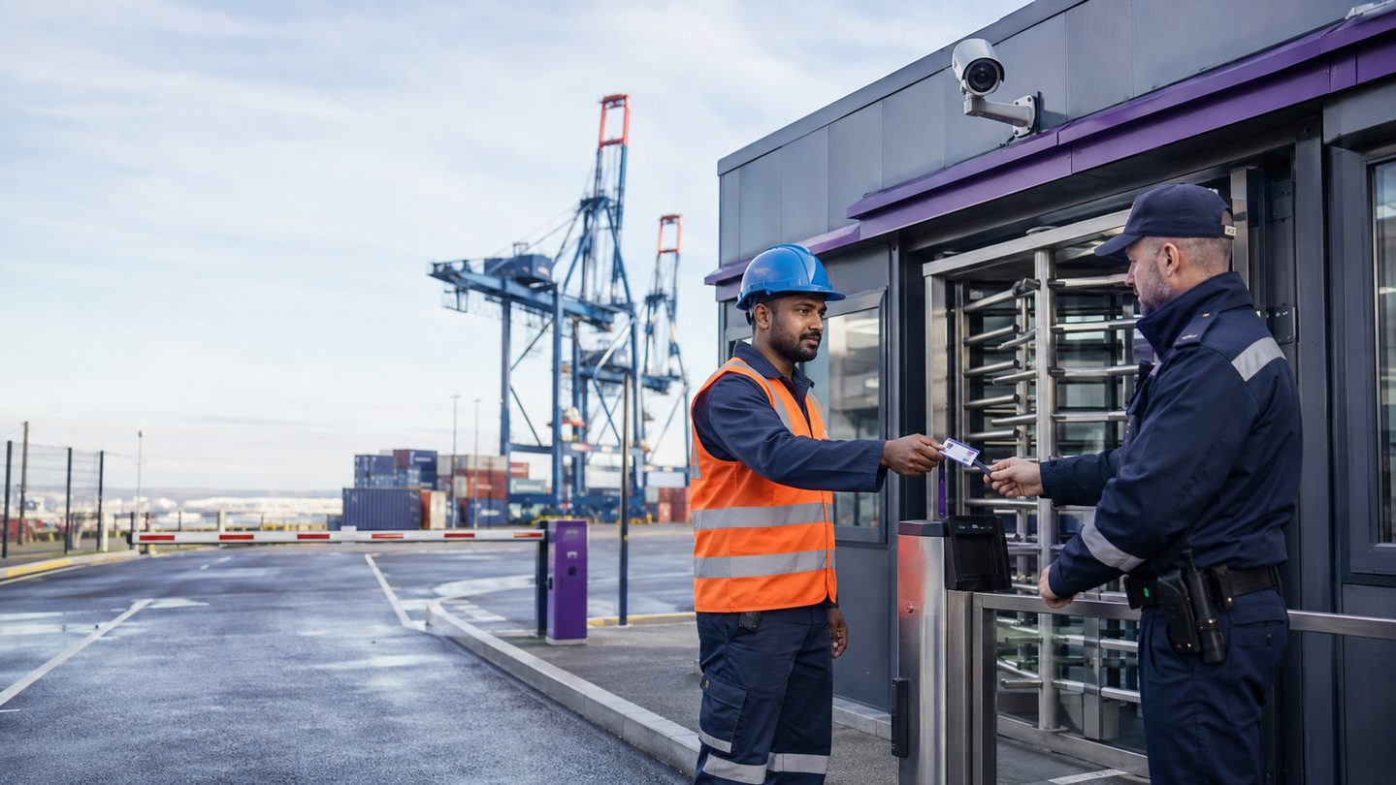
Identity is a security control
Effective access control verifies:
Who the person is
Why access is required
Where and when access is authorised
Whether the credential remains valid
How exceptions and visitors are controlled
Trust is verified—not assumed.
Notes:
Use the photograph to identify layers: credential, trained officer, turnstile, CCTV, vehicle barrier and perimeter. Discuss how technology supports—but does not replace—procedure and judgement.
[Sources]
- London Gateway College, Port Security Management course source, section 1.6.
- Image: AI-generated for this deck; no external asset source.
[/Sources]

Slide 22
PORT SECURITY MANAGEMENT • PSM-28 • LECTURE 1
Credentialing case study: TWIC
UNITED STATES EXAMPLE
TRANSFERABLE LESSONS
Transportation Worker Identification Credential
Biometric assurance
Background screening
Credential lifecycle
Reader + process integration
Authorised under the Maritime Transportation Security Act 2002 and introduced to strengthen identity assurance for unescorted access to secure maritime areas.
TWIC is not a UK credential. Apply the design principles through the approved identity and access arrangements for the relevant UK port or facility.
22
Notes:
Prevent a common misconception: TWIC is a US programme. Use it as a case study in layered identity assurance, then return learners to their applicable UK arrangements.
[Sources]
- London Gateway College, Port Security Management course source, section 1.6.
[/Sources]

Slide 23
PORT SECURITY MANAGEMENT • PSM-28 • LECTURE 1
Government–business partnerships
No single organisation owns the whole port-security problem.
GOVERNMENT
PORT AUTHORITY
Policy, threat information and oversight
Coordination, plans and common infrastructure
OPERATORS & TENANTS
CONTROL AGENCIES
Daily controls, staff and commercial systems
Border, customs, police and emergency response
Share objectives • define interfaces • exchange information • exercise together
23
Notes:
Relate partnerships to limited budgets, self-funded operations and shared consequences. The UK Port Security Regulations require adequate liaison and cooperation with UK control authorities.
[Sources]
- London Gateway College, Port Security Management course source, section 1.7.
- The Port Security Regulations 2009, regulation 11: https://www.legislation.gov.uk/uksi/2009/2048
[/Sources]

Slide 24
PORT SECURITY MANAGEMENT • PSM-28 • LECTURE 1
Strategic port security
Strategy aligns protection, performance and resilience.
OUTCOME
Safe, secure and reliable trade
GOVERNANCE
Accountability • priorities • resources
ASSURANCE
Assessment • plans • audit • exercises
OPERATIONS
People • access • cargo • vessels • response
CULTURE
Leadership • competence • reporting • learning
Strategic question: are our controls reducing priority risks while sustaining essential operations?
24
Notes:
Use the layered model to show vertical alignment. Controls should trace upward to an assessed risk and strategic outcome; governance should ensure resources and accountability.
[Sources]
- London Gateway College, Port Security Management course source, section 1.8 and conclusion.
[/Sources]

Slide 25
PORT SECURITY MANAGEMENT • PSM-28 • LECTURE 1
Applied scenario: protect trade
A credible warning concerns a small craft and possible insider support. A high-volume vessel call is due in 90 minutes.
PRIORITISE
COORDINATE
CONTROL
CONTINUE
What must be protected first?
Who needs to know and act?
Which layered measures are proportionate?
What operations can proceed safely?
Record assumptions. Use approved escalation routes. Review as information changes.
25
Notes:
Facilitate a short tabletop discussion. Look for risk-based decisions, waterside and landside coordination, information handling, operational continuity, escalation and review. Do not invite disclosure of real vulnerabilities.
[Sources]
- Scenario synthesised from London Gateway College course source, Lecture 1.
[/Sources]

Slide 26
PORT SECURITY MANAGEMENT • PSM-28 • LECTURE 1
Knowledge check
Which statement best reflects modern port security management?
A
Security is mainly a perimeter-guarding function.
B
Security is a risk-based management responsibility integrated with port operations.
C
Security should always take priority over continuity, regardless of assessed risk.
D
Technology can replace stakeholder coordination and security culture.
Choose one answer and justify it using two ideas from this lecture.
26
Notes:
Correct answer: B. Ask learners to justify the answer before revealing it. A is too narrow; C ignores proportionality; D overstates technology and ignores human and organisational controls.
[Sources]
- Assessment item based on London Gateway College course source, Lecture 1.
[/Sources]

Slide 27
PORT SECURITY MANAGEMENT • PSM-28 • LECTURE 1
Lecture 1: key takeaways
1
Ports are connected systems whose security failures can cascade.
2
Post-2001 frameworks made security a core management duty.
3
Threats exploit waterside, landside, cargo, people and information interfaces.
4
Security culture and verified access are essential layers.
5
Partnerships and risk-based decisions protect both safety and trade.
Next lecture: a managerial approach to maritime and port security
27
Notes:
Close by asking each learner to state one practice they will observe differently after this lecture. Revisit the four lecture objectives and confirm coverage.
[Sources]
- London Gateway College, Port Security Management course source, Lecture 1 conclusion.
[/Sources]

Slide 28
PORT SECURITY MANAGEMENT • PSM-28 • LECTURE 1
References and further learning
Core course source
London Gateway College. Port Security Management (PSM-28), Lecture 1: Introduction to Port Security Management.
Authoritative framework sources
International Maritime Organization — SOLAS Chapter XI-2 and the ISPS Code
UK Government — Ship security / maritime security guidance
The Port Security Regulations 2009 (SI 2009/2048), as amended
Historical figures and case references are presented as stated in the supplied course source. Operational decisions should use current official intelligence, approved plans and local directions.
© London Gateway College • Training use
28
Notes:
Use these sources for trainer preparation and periodic course review. Check for amendments before each formal course update.
[Sources]
- https://www.imo.org/en/ourwork/security/pages/solas-xi-2%20isps%20code.aspx
- https://www.gov.uk/guidance/maritime-security
- https://www.legislation.gov.uk/uksi/2009/2048
[/Sources]

