Slide 1
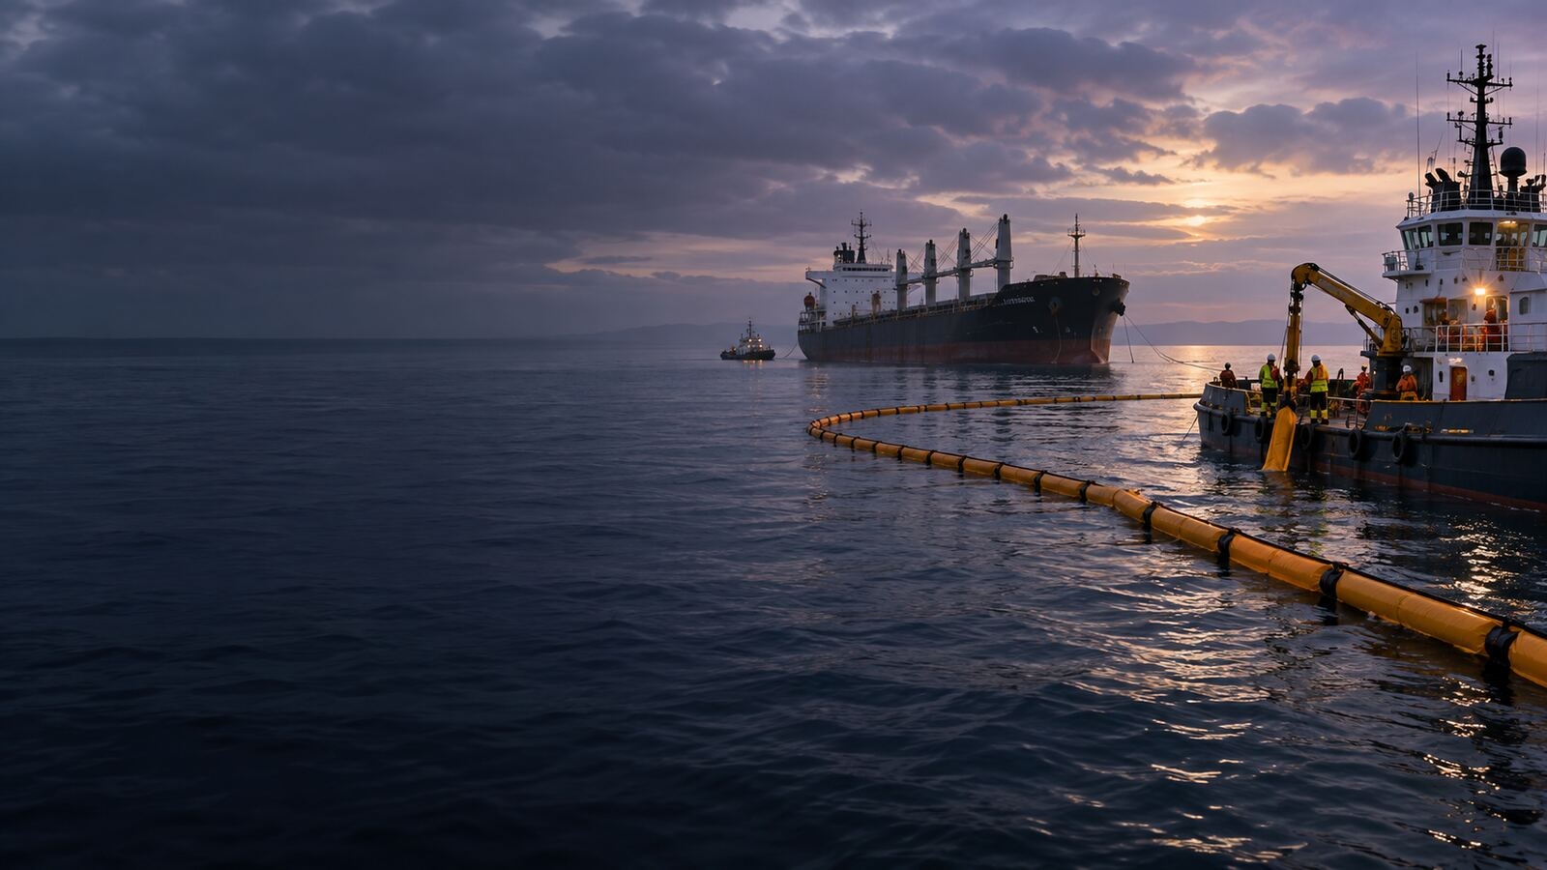

LONDON GATEWAY COLLEGE
LECTURE 2
OIL POLLUTION CLAIMS AND PUBLIC NUISANCE
Oil Pollution and Compensation Law
Course Code LGC300
Notes:
Source: London Gateway College supplied course material, Oil Pollution and Compensation Law (LGC300). LECTURE 2. Educational use only.

Slide 2
LONDON GATEWAY COLLEGE
LGC300
Learning focus
• Explain the principal concepts associated with oil pollution claims and public nuisance.
• Apply the lecture principles to a realistic professional situation.
• Identify the evidence, authority and judgement required for a defensible conclusion.
• Understanding Public Nuisance in Environmental Contexts
• THE LEGAL FRAMEWORK OF PUBLIC NUISANCE
• CASE STUDY: THE SEA EMPRESS OIL SPILL
Oil Pollution and Compensation Law 02
Notes:
Source: London Gateway College supplied course material, Oil Pollution and Compensation Law (LGC300). Learning focus. Educational use only.

Slide 3
LONDON GATEWAY COLLEGE
LGC300
Understanding Public Nuisance in Environmental Contexts
• Consider the comparison: allowing draught horses to leave waste outside a London coffeehouse is akin to permitting a vessel to discharge oil improperly at sea.
• Similarly, operating an unregulated brothel in a residential area can be likened to reducing ferry services between Gravesend and Tilbury or running an unsafe, single-hulled oil tanker that later causes environmental catastrophe.
• Just as quarry blasting that sends stone debris into neighboring areas constitutes public nuisance, so too does constructing a jetty that leads to excessive siltation in a river.
• These scenarios illustrate the broad application of public nuisance law.
Oil Pollution and Compensation Law 03
Notes:
Source: London Gateway College supplied course material, Oil Pollution and Compensation Law (LGC300). Understanding Public Nuisance in Environmental Contexts. Educational use only.

Slide 4
LONDON GATEWAY COLLEGE
LGC300
THE LEGAL FRAMEWORK OF PUBLIC NUISANCE
• Public nuisance is an offence under English common law that can also lead to civil claims in tort.
• Legally, an individual is guilty of public nuisance if they commit an unlawful act or neglect a legal duty in a manner that endangers public health, safety, property, or general well-being, or obstructs the rights commonly.
• While the law of public nuisance has been criticized for its broad and flexible nature, it remains significant due to its adaptability in areas not covered by specific legislation.
• v Goldstein, the House of Lords upheld the offence’s validity, dismissing concerns that it lacked clarity.
Oil Pollution and Compensation Law 04
Notes:
Source: London Gateway College supplied course material, Oil Pollution and Compensation Law (LGC300). THE LEGAL FRAMEWORK OF PUBLIC NUISANCE. Educational use only.

Slide 5
LONDON GATEWAY COLLEGE
LGC300
CASE STUDY: THE SEA EMPRESS OIL SPILL
• A significant example of oil pollution with widespread consequences is the Sea Empress disaster.
• On February 15, 1996, the Sea Empress, a single-hulled oil tanker, was en route to Milford Haven carrying 130,994 tonnes of light crude oil.
• Upon striking mid-channel rocks, the vessel immediately spilled 2,500 tonnes of crude oil, later grounding in Mill Bay.
• Over the next six days, worsening weather conditions complicated salvage efforts, leading to an additional spill of 69,300 tonnes of crude oil and 500 tonnes of fuel oil—most of which entered the sea less than a mile from.
Oil Pollution and Compensation Law 05
Notes:
Source: London Gateway College supplied course material, Oil Pollution and Compensation Law (LGC300). CASE STUDY: THE SEA EMPRESS OIL SPILL. Educational use only.

Slide 6
LONDON GATEWAY COLLEGE
LGC300
Legal and Economic Repercussions
• In the case of Environment Agency v Milford Haven Port Authority (1999), the MHPA was prosecuted under the Water Resources Act 1991 for its role in the disaster, receiving an initial fine of £4 million, later reduced to.
• The impact of the pollution extended beyond the direct environmental harm:
• Over £60 million was spent on cleanup operations.
• Fishing and shellfish harvesting were banned for months.
Oil Pollution and Compensation Law 06
Notes:
Source: London Gateway College supplied course material, Oil Pollution and Compensation Law (LGC300). Legal and Economic Repercussions. Educational use only.

Slide 7
LONDON GATEWAY COLLEGE
LGC300
PUBLIC NUISANCE AS A LEGAL TOOL FOR ENVIRONMENTAL DAMAGE
• Historically, public nuisance law has been used to address harm that broadly affects communities, as exemplified in Blackstone’s Commentaries on the Laws of England.
• The legal precedent suggests that widespread physical and economic damage caused by pollution aligns with the principles of public nuisance, which focus on the infringement of public rights.
• A more recent terrestrial example is the 2005 Buncefield oil depot explosion in Hertfordshire, where widespread environmental contamination led to legal claims against Total, the responsible party.
• In this case, public nuisance claims were instrumental in securing compensation for affected residents and businesses.
Oil Pollution and Compensation Law 07
Notes:
Source: London Gateway College supplied course material, Oil Pollution and Compensation Law (LGC300). PUBLIC NUISANCE AS A LEGAL TOOL FOR ENVIRONMENTAL DAMAGE. Educational use only.

Slide 8
LONDON GATEWAY COLLEGE
LGC300
Origins of Nuisance in Common Law
• The concept of nuisance in common law arose from the need to protect landowners' rights and interests.
• Initially, legal remedies were provided for those dispossessed of their land through actions such as the Writ of Right and, later, the Assize of Novel Disseisin, which allowed recovery of property.
• Additionally, trespass actions were established to address unauthorized entry and damage to land.
• However, landowners could suffer interference with the enjoyment of their property without direct dispossession.
Oil Pollution and Compensation Law 08
Notes:
Source: London Gateway College supplied course material, Oil Pollution and Compensation Law (LGC300). Origins of Nuisance in Common Law. Educational use only.

Slide 9
LONDON GATEWAY COLLEGE
LGC300
Distinction Between Private and Public Nuisance
• Over time, legal distinctions emerged between private and public nuisance.
• Private nuisance involved specific harm to an individual’s use and enjoyment of land, such as pollution, noise, or obstructed access.
• In contrast, public nuisance concerned actions that harmed the general public, such as blocking roads or contaminating water sources.
• Courts recognized that these public harms needed to be addressed through criminal prosecution or government action rather than individual lawsuits.
Oil Pollution and Compensation Law 09
Notes:
Source: London Gateway College supplied course material, Oil Pollution and Compensation Law (LGC300). Distinction Between Private and Public Nuisance. Educational use only.

Slide 10
LONDON GATEWAY COLLEGE
LGC300
Applied activity
• Review a fictional or public scenario involving oil pollution claims and public nuisance.
• Identify the material facts, unresolved assumptions and governing principles.
• Prepare an issue and evidence matrix before reaching a conclusion.
• Recommend practical action and explain any point requiring specialist advice.
Oil Pollution and Compensation Law 10
Notes:
Source: London Gateway College supplied course material, Oil Pollution and Compensation Law (LGC300). Applied activity. Educational use only.

Slide 11
LONDON GATEWAY COLLEGE
LGC300
Knowledge check
• What is the central principle examined in oil pollution claims and public nuisance?
• Which facts would materially change the analysis?
• Which source provides the strongest authority for your conclusion?
• What evidence should a professional obtain first?
• Which risk, remedy or control should receive priority, and why?
Oil Pollution and Compensation Law 11
Notes:
Source: London Gateway College supplied course material, Oil Pollution and Compensation Law (LGC300). Knowledge check. Educational use only.

Slide 12
LONDON GATEWAY COLLEGE
LGC300
Independent research task
• Consult at least two authoritative sources listed in the lecture learning guide.
• Prepare a 900 to 1,100 word professional response and a one-page issue or evidence matrix.
• Cite every external source and record the date accessed.
• Upload the final work, source list and originality declaration to the LMS.
Oil Pollution and Compensation Law 12
Notes:
Source: London Gateway College supplied course material, Oil Pollution and Compensation Law (LGC300). Independent research task. Educational use only.

Slide 13
LONDON GATEWAY COLLEGE
LGC300
Lecture summary
• Understanding Public Nuisance in Environmental Contexts
• THE LEGAL FRAMEWORK OF PUBLIC NUISANCE
• CASE STUDY: THE SEA EMPRESS OIL SPILL
• Legal and Economic Repercussions
• PUBLIC NUISANCE AS A LEGAL TOOL FOR ENVIRONMENTAL DAMAGE
Oil Pollution and Compensation Law 13
Notes:
Source: London Gateway College supplied course material, Oil Pollution and Compensation Law (LGC300). Lecture summary. Educational use only.

Slide 14
LONDON GATEWAY COLLEGE
LGC300
Recommended sources
• IMO Civil Liability Convention
• IMO Fund Convention
• International Oil Pollution Compensation Funds
• IMO MARPOL Convention
• London Gateway College Oil Pollution and Compensation Law course material
Oil Pollution and Compensation Law 14
Notes:
Source: London Gateway College supplied course material, Oil Pollution and Compensation Law (LGC300). Recommended sources. Educational use only.

