Slide 1
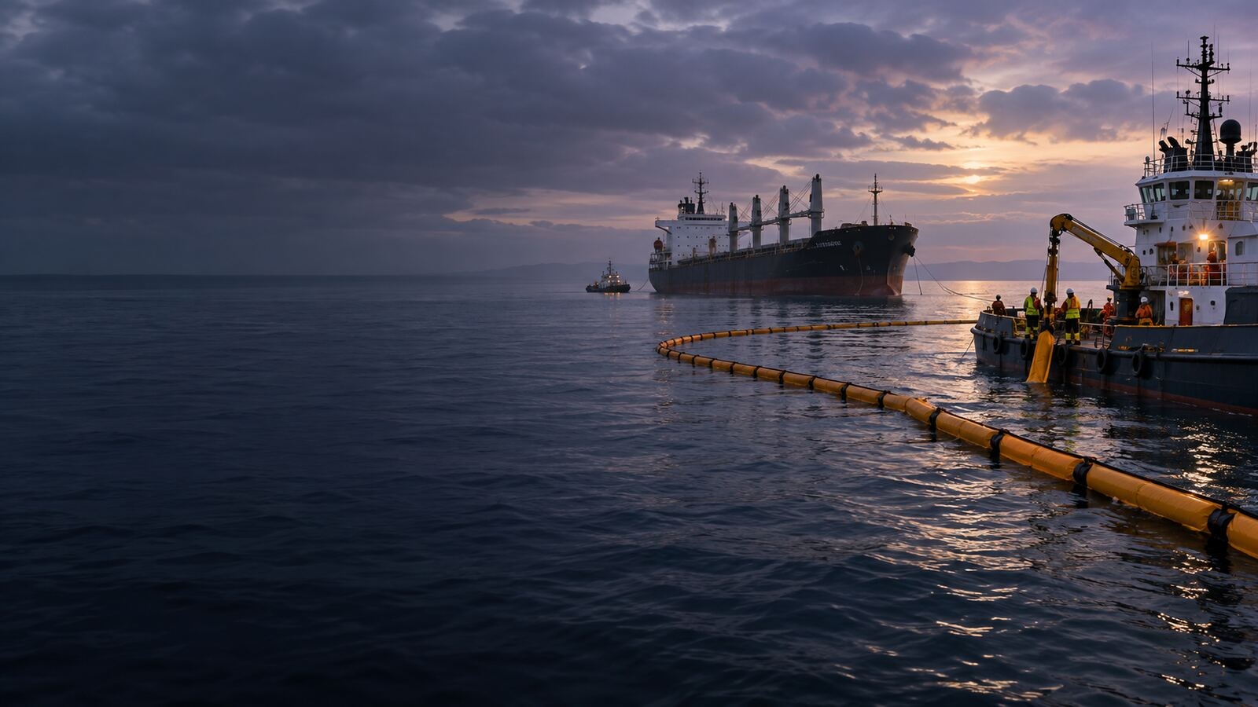

LONDON GATEWAY COLLEGE
LECTURE 3
LEGAL PRECEDENTS AND THE EVOLUTION OF PUBLIC NUISANCE
Oil Pollution and Compensation Law
Course Code LGC300
Notes:
Source: London Gateway College supplied course material, Oil Pollution and Compensation Law (LGC300). LECTURE 3. Educational use only.

Slide 2
LONDON GATEWAY COLLEGE
LGC300
Learning focus
• Explain the principal concepts associated with legal precedents and the evolution of public nuisance.
• Apply the lecture principles to a realistic professional situation.
• Identify the evidence, authority and judgement required for a defensible conclusion.
• Overview
• The Requirement of Special Damage
• Overlapping Nature of Public and Private Nuisance
Oil Pollution and Compensation Law 02
Notes:
Source: London Gateway College supplied course material, Oil Pollution and Compensation Law (LGC300). Learning focus. Educational use only.

Slide 3
LONDON GATEWAY COLLEGE
LGC300
Overview
• Cases such as Wigg’s Case (1705) and Hall’s Case (1671) reinforced the principle that nuisances affecting the community at large were treated as public nuisances.
• These included activities like maintaining unsanitary conditions in public spaces, obstructing streets, or operating dangerous businesses in populated areas.
• By the 19th century, legal references such as Archbold’s 1822 writings identified various public nuisances, including keeping wild animals in public areas and maintaining hazardous structures near roadways.
• Because public nuisance affected the community rather than individuals, legal action was primarily pursued through criminal charges or injunctions brought by government authorities, often through the Attorney General acting.
Oil Pollution and Compensation Law 03
Notes:
Source: London Gateway College supplied course material, Oil Pollution and Compensation Law (LGC300). Overview. Educational use only.

Slide 4
LONDON GATEWAY COLLEGE
LGC300
The Requirement of Special Damage
• An important legal principle in public nuisance is the requirement that a claimant demonstrate special damage distinct from that suffered by the general public.
• This principle, first articulated in Sowthall v.
• Dagger (1535) and later reaffirmed in Fowler v.
• Saunders (1617), established that individuals could seek compensation only if they suffered unique harm beyond what was experienced by the broader community.
Oil Pollution and Compensation Law 04
Notes:
Source: London Gateway College supplied course material, Oil Pollution and Compensation Law (LGC300). The Requirement of Special Damage. Educational use only.

Slide 5
LONDON GATEWAY COLLEGE
LGC300
Overlapping Nature of Public and Private Nuisance
• It is important to note that private and public nuisance are not mutually exclusive, and a single act may constitute both.
• This was demonstrated in Fritz v Hobson (1880), where an antique dealer successfully claimed both private nuisance (due to obstruction of his shop entrance) and public nuisance (from the obstruction of public pathways).
• Similarly, in Colour Quest Ltd v Total Downstream UK (2009), arising from the 2005 Buncefield explosion, the court rejected the argument that claims in public and private nuisance were mutually exclusive.
• The judgment clarified that while private nuisance involves interference with land use, public nuisance concerns threats to public health, safety, and comfort.
Oil Pollution and Compensation Law 05
Notes:
Source: London Gateway College supplied course material, Oil Pollution and Compensation Law (LGC300). Overlapping Nature of Public and Private Nuisance. Educational use only.

Slide 6
LONDON GATEWAY COLLEGE
LGC300
Classification of Public Nuisance
• Public nuisance can be categorized into two main types:
• Cases that overlap with private nuisance, where interference with land affects a larger group of people than usual in private nuisance claims.
• Cases that do not meet the private nuisance requirement of land interference but instead impact public safety or convenience.
• This classification is reflected in Jan de Nul (UK) Ltd v NV Royal Belge, where dredging operations caused silting that affected commercial operations and oyster beds.
Oil Pollution and Compensation Law 06
Notes:
Source: London Gateway College supplied course material, Oil Pollution and Compensation Law (LGC300). Classification of Public Nuisance. Educational use only.

Slide 7
LONDON GATEWAY COLLEGE
LGC300
Relevance of Public Nuisance in Modern Oil Pollution Cases
• Public nuisance remains relevant, particularly in environmental and oil pollution cases.
• Unlike negligence, which requires proof of duty and breach, public nuisance provides a broader framework for holding defendants accountable for widespread harm.
• For example, in an oil spill incident:
• A fisherman whose nets and lobster pots are damaged by oil may claim negligence for economic loss but may also claim public nuisance if the pollution affects the broader community.
Oil Pollution and Compensation Law 07
Notes:
Source: London Gateway College supplied course material, Oil Pollution and Compensation Law (LGC300). Relevance of Public Nuisance in Modern Oil Pollution Cases. Educational use only.

Slide 8
LONDON GATEWAY COLLEGE
LGC300
Applied activity
• Review a fictional or public scenario involving legal precedents and the evolution of public nuisance.
• Identify the material facts, unresolved assumptions and governing principles.
• Prepare an issue and evidence matrix before reaching a conclusion.
• Recommend practical action and explain any point requiring specialist advice.
Oil Pollution and Compensation Law 08
Notes:
Source: London Gateway College supplied course material, Oil Pollution and Compensation Law (LGC300). Applied activity. Educational use only.

Slide 9
LONDON GATEWAY COLLEGE
LGC300
Knowledge check
• What is the central principle examined in legal precedents and the evolution of public nuisance?
• Which facts would materially change the analysis?
• Which source provides the strongest authority for your conclusion?
• What evidence should a professional obtain first?
• Which risk, remedy or control should receive priority, and why?
Oil Pollution and Compensation Law 09
Notes:
Source: London Gateway College supplied course material, Oil Pollution and Compensation Law (LGC300). Knowledge check. Educational use only.

Slide 10
LONDON GATEWAY COLLEGE
LGC300
Independent research task
• Consult at least two authoritative sources listed in the lecture learning guide.
• Prepare a 900 to 1,100 word professional response and a one-page issue or evidence matrix.
• Cite every external source and record the date accessed.
• Upload the final work, source list and originality declaration to the LMS.
Oil Pollution and Compensation Law 10
Notes:
Source: London Gateway College supplied course material, Oil Pollution and Compensation Law (LGC300). Independent research task. Educational use only.

Slide 11
LONDON GATEWAY COLLEGE
LGC300
Lecture summary
• Overview
• The Requirement of Special Damage
• Overlapping Nature of Public and Private Nuisance
• Classification of Public Nuisance
• Relevance of Public Nuisance in Modern Oil Pollution Cases
Oil Pollution and Compensation Law 11
Notes:
Source: London Gateway College supplied course material, Oil Pollution and Compensation Law (LGC300). Lecture summary. Educational use only.

Slide 12
LONDON GATEWAY COLLEGE
LGC300
Recommended sources
• IMO Civil Liability Convention
• IMO Fund Convention
• International Oil Pollution Compensation Funds
• IMO MARPOL Convention
• London Gateway College Oil Pollution and Compensation Law course material
Oil Pollution and Compensation Law 12
Notes:
Source: London Gateway College supplied course material, Oil Pollution and Compensation Law (LGC300). Recommended sources. Educational use only.

