Slide 1
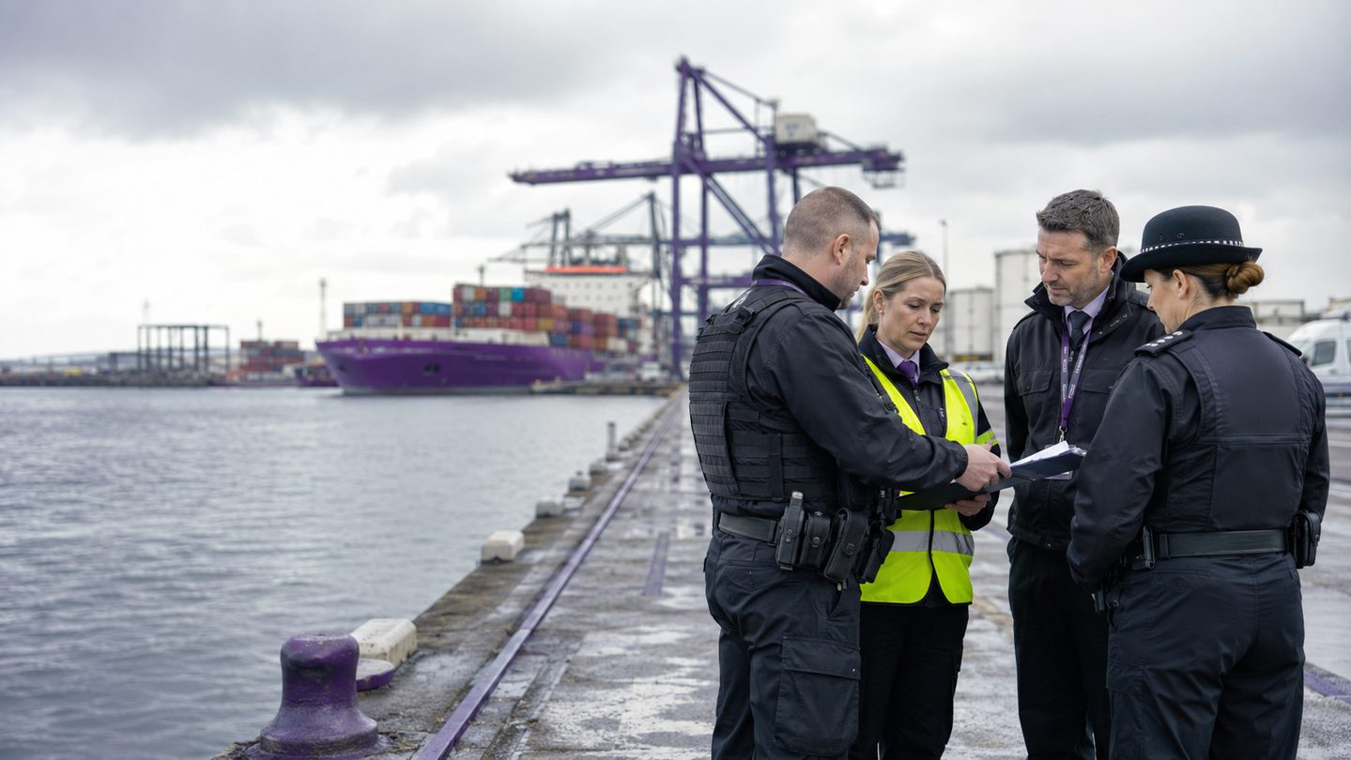

LONDON GATEWAY COLLEGE
PORT SECURITY
MANAGEMENT
Course code: PSM-28
LECTURE 13
Effective Management for Securing Port Facilities
Comprehensive learning aid • CPD training deck
Notes:
Introduce the lecture, connect it to the course aim and invite one operational expectation.
[Sources]
- London Gateway College, Port Security Management (PSM-28), supplied course source.
- Cover image: AI-generated specifically for this learning aid.
[/Sources]

Slide 2
PORT SECURITY MANAGEMENT • PSM-28 • LECTURE 13
Course aim
Develop confident, risk-aware port security practitioners
LEARNERS WILL
The course provides a comprehensive understanding of the principles, practices and regulatory frameworks that underpin security in the global maritime industry.
Identify
Assess
Manage
security risks in port environments
People • Cargo • Vessels • Infrastructure • Trade
Professional emphasis: proactive risk management, emergency preparedness, compliance, technology, collaboration and ethical practice.
02
Notes:
Relate the course aim to the learner's role and local operating context.
[Sources]
- London Gateway College, Port Security Management (PSM-28), supplied course source.
[/Sources]

Slide 3
PORT SECURITY MANAGEMENT • PSM-28 • LECTURE 13
Course learning outcomes — foundations
On successful completion, learners will be able to:
01
Explain core port-security concepts and strategic importance
02
Critically assess legal and regulatory frameworks, including SOLAS and the ISPS Code
03
Identify physical, cyber, criminal and insider threats
04
Develop security plans covering assessment, access, surveillance, response and communication
05
Explain stakeholder roles across port authorities, security, customs and international agencies
03
Notes:
Use outcomes 1–5 as a learning contract and connect them to earlier lectures.
[Sources]
- London Gateway College, Port Security Management (PSM-28), supplied course source.
[/Sources]

Slide 4
PORT SECURITY MANAGEMENT • PSM-28 • LECTURE 13
Course learning outcomes — application
Learners will also be able to:
06
Apply risk-management principles to vulnerability assessment and mitigation
07
Analyse security technologies such as CCTV, biometrics, AIS and cyber tools
08
Evaluate incidents and turn lessons learned into stronger controls
09
Communicate during crises, inter-agency coordination and stakeholder reporting
10
Act ethically and lawfully while protecting rights and civil liberties
04
Notes:
Emphasise application, ethical judgement and evidence-based practice.
[Sources]
- London Gateway College, Port Security Management (PSM-28), supplied course source.
[/Sources]

Slide 5
PORT SECURITY MANAGEMENT • PSM-28 • LECTURE 13
Lecture 13: learning objectives
01
Effective Management for Securing Port Facilities
Governance, law-enforcement collaboration, suspicious activity, resources and systemic improvement.
Define security organisation, authority and accountability
Coordinate port security and law-enforcement roles
Manage suspicious activity from report to recovery
Balance regulation, finance, operations and collaborative assurance
05
Notes:
Review the lecture objectives and explain the route from principles to applied judgement.
[Sources]
- London Gateway College, Port Security Management (PSM-28), supplied course source.
[/Sources]

Slide 6
PORT SECURITY MANAGEMENT • PSM-28 • LECTURE 13
Management makes security dependable
Effective protection aligns authority, resources, operations and partner action around priority risk.
GOVERN
ORGANISE
OPERATE
ASSURE
Purpose, policy and accountability
Roles, competence and interfaces
Controls, decisions and response
Evidence, challenge and improvement
A control becomes reliable only when ownership and performance are visible.
06
Notes:
Explain the framework, apply it to a familiar port process and identify evidence of effective implementation.
[Sources]
- London Gateway College, Port Security Management (PSM-28), supplied course source.
- https://www.imo.org/en/ourwork/security/pages/solas-xi-2%20isps%20code.aspx
- https://www.gov.uk/guidance/maritime-security
- https://www.legislation.gov.uk/uksi/2009/2048
- https://www.imo.org/en/OurWork/Security/Pages/Whole-of-Government-Approach-to-Maritime-Security.aspx
- https://ico.org.uk/for-organisations/uk-gdpr-guidance-and-resources/
[/Sources]

Slide 7
PORT SECURITY MANAGEMENT • PSM-28 • LECTURE 13
Security organisation: clarity before crisis
People should know who decides, who acts and who must be consulted.
ACCOUNTABLE
RESPONSIBLE
SUPPORT
PARTNERS
Senior owner accepts risk and resources
PFSO and managers coordinate delivery
Operations, HR, IT, safety and contractors
Police, border, emergency and competent authorities
Document deputies, 24-hour contacts, escalation and handover.
07
Notes:
Explain the framework, apply it to a familiar port process and identify evidence of effective implementation.
[Sources]
- London Gateway College, Port Security Management (PSM-28), supplied course source.
- https://www.imo.org/en/ourwork/security/pages/solas-xi-2%20isps%20code.aspx
- https://www.gov.uk/guidance/maritime-security
- https://www.legislation.gov.uk/uksi/2009/2048
- https://www.imo.org/en/OurWork/Security/Pages/Whole-of-Government-Approach-to-Maritime-Security.aspx
- https://ico.org.uk/for-organisations/uk-gdpr-guidance-and-resources/
[/Sources]

Slide 8
PORT SECURITY MANAGEMENT • PSM-28 • LECTURE 13
Port security and law enforcement
PORT SECURITY
LAW ENFORCEMENT
SHARED SPACE
Daily protective measures, observation, access and operational knowledge
Statutory powers, investigation, public protection and criminal justice
Threat assessment, incident coordination, evidence and recovery
Collaboration must preserve lawful authority, safety and operational command.
08
Notes:
Explain the framework, apply it to a familiar port process and identify evidence of effective implementation.
[Sources]
- London Gateway College, Port Security Management (PSM-28), supplied course source.
- https://www.imo.org/en/ourwork/security/pages/solas-xi-2%20isps%20code.aspx
- https://www.gov.uk/guidance/maritime-security
- https://www.legislation.gov.uk/uksi/2009/2048
- https://www.imo.org/en/OurWork/Security/Pages/Whole-of-Government-Approach-to-Maritime-Security.aspx
- https://ico.org.uk/for-organisations/uk-gdpr-guidance-and-resources/
[/Sources]

Slide 9
PORT SECURITY MANAGEMENT • PSM-28 • LECTURE 13
Administrative and operational roles
Partners need agreement on both governance and scene-level action.
ADMINISTER
Policies, contacts, information rules and exercise programme
Do not wait for an incident to discover incompatible procedures.
PREPARE
Threat briefings, plans and resource assumptions
RESPOND
Command, cordons, powers, evidence and communication
REVIEW
Debrief, investigation and corrective action
09
Notes:
Explain the framework, apply it to a familiar port process and identify evidence of effective implementation.
[Sources]
- London Gateway College, Port Security Management (PSM-28), supplied course source.
- https://www.imo.org/en/ourwork/security/pages/solas-xi-2%20isps%20code.aspx
- https://www.gov.uk/guidance/maritime-security
- https://www.legislation.gov.uk/uksi/2009/2048
- https://www.imo.org/en/OurWork/Security/Pages/Whole-of-Government-Approach-to-Maritime-Security.aspx
- https://ico.org.uk/for-organisations/uk-gdpr-guidance-and-resources/
[/Sources]

Slide 10
PORT SECURITY MANAGEMENT • PSM-28 • LECTURE 13
Learner activity: ambiguous behaviour
A contractor repeatedly photographs a restricted berth, gives inconsistent reasons and attempts to leave when challenged.
What behaviour is observable?
What action is proportionate now?
When should police be contacted?
What evidence must be protected?
Create a safe report, escalation decision and handover brief.
10
Notes:
Run the activity in pairs. Require assumptions, accountable owners and evidence before debriefing.
[Sources]
- London Gateway College, Port Security Management (PSM-28), supplied course source.
- https://www.imo.org/en/ourwork/security/pages/solas-xi-2%20isps%20code.aspx
- https://www.gov.uk/guidance/maritime-security
- https://www.legislation.gov.uk/uksi/2009/2048
- https://www.imo.org/en/OurWork/Security/Pages/Whole-of-Government-Approach-to-Maritime-Security.aspx
- https://ico.org.uk/for-organisations/uk-gdpr-guidance-and-resources/
[/Sources]

Slide 11

Suspicion is managed through disciplined action
Observe • Protect • Report • Assess • Handover
• Describe behaviour, not stereotypes
• Keep people and scene safe
• Use approved reporting routes
• Preserve CCTV and access evidence
• Record decisions and rationale
Notes:
Use the image to separate observed facts, reasonable inference and questions requiring verification.
[Sources]
- London Gateway College, Port Security Management (PSM-28), supplied course source.
- Image: AI-generated specifically for this learning aid.
[/Sources]

Slide 12
PORT SECURITY MANAGEMENT • PSM-28 • LECTURE 13
Suspicious-activity management
A consistent pathway helps weak signals become informed decisions.
ALERT
ASSESS
→
→
ACT
Who, what, where, when and immediate risk
Credibility, context and corroboration
Proportionate control, specialist advice and review
12
Notes:
Explain the framework, apply it to a familiar port process and identify evidence of effective implementation.
[Sources]
- London Gateway College, Port Security Management (PSM-28), supplied course source.
- https://www.imo.org/en/ourwork/security/pages/solas-xi-2%20isps%20code.aspx
- https://www.gov.uk/guidance/maritime-security
- https://www.legislation.gov.uk/uksi/2009/2048
- https://www.imo.org/en/OurWork/Security/Pages/Whole-of-Government-Approach-to-Maritime-Security.aspx
- https://ico.org.uk/for-organisations/uk-gdpr-guidance-and-resources/
[/Sources]

Slide 13
PORT SECURITY MANAGEMENT • PSM-28 • LECTURE 13
Evidence-preserving response
SAFETY
Separate fact from inference
Protect life and avoid unnecessary confrontation
MATERIAL
Do not contaminate the scene
Protect CCTV, access logs and relevant objects
INFORMATION
Maintain continuity
Record exact observations, time and source
HANDOVER
State action taken, authority and outstanding risk
13
Notes:
Explain the framework, apply it to a familiar port process and identify evidence of effective implementation.
[Sources]
- London Gateway College, Port Security Management (PSM-28), supplied course source.
- https://www.imo.org/en/ourwork/security/pages/solas-xi-2%20isps%20code.aspx
- https://www.gov.uk/guidance/maritime-security
- https://www.legislation.gov.uk/uksi/2009/2048
- https://www.imo.org/en/OurWork/Security/Pages/Whole-of-Government-Approach-to-Maritime-Security.aspx
- https://ico.org.uk/for-organisations/uk-gdpr-guidance-and-resources/
[/Sources]

Slide 14
PORT SECURITY MANAGEMENT • PSM-28 • LECTURE 13
Information sharing with partners
NECESSARY
Supports a defined protection, investigation or response purpose
Relevant detail, controlled recipients and lawful basis
Approved channels, markings and handling
Record disclosure, decision and follow-up
PROPORTIONATE
SECURE
ACCOUNTABLE
Clear purpose
Minimum required
Protect sources
Urgency does not remove the need for judgement and control.
Agree protocols before pressure rises.
14
Notes:
Explain the framework, apply it to a familiar port process and identify evidence of effective implementation.
[Sources]
- London Gateway College, Port Security Management (PSM-28), supplied course source.
- https://www.imo.org/en/ourwork/security/pages/solas-xi-2%20isps%20code.aspx
- https://www.gov.uk/guidance/maritime-security
- https://www.legislation.gov.uk/uksi/2009/2048
- https://www.imo.org/en/OurWork/Security/Pages/Whole-of-Government-Approach-to-Maritime-Security.aspx
- https://ico.org.uk/for-organisations/uk-gdpr-guidance-and-resources/
[/Sources]

Slide 15
PORT SECURITY MANAGEMENT • PSM-28 • LECTURE 13
Regulatory requirements and management
DUTY
Core disciplines
Identify applicable duties
Assign accountable owners
Resource implementation
Retain required evidence
Audit, report and correct
Control changes and exemptions
Management translates legal and competent-authority requirements into usable local controls
Compliance is a minimum condition—not the complete definition of effective security.
15
Notes:
Explain the framework, apply it to a familiar port process and identify evidence of effective implementation.
[Sources]
- London Gateway College, Port Security Management (PSM-28), supplied course source.
- https://www.imo.org/en/ourwork/security/pages/solas-xi-2%20isps%20code.aspx
- https://www.gov.uk/guidance/maritime-security
- https://www.legislation.gov.uk/uksi/2009/2048
- https://www.imo.org/en/OurWork/Security/Pages/Whole-of-Government-Approach-to-Maritime-Security.aspx
- https://ico.org.uk/for-organisations/uk-gdpr-guidance-and-resources/
[/Sources]

Slide 16
PORT SECURITY MANAGEMENT • PSM-28 • LECTURE 13
Financial impact and operational constraints
RISK
LIFECYCLE COST
OPERABILITY
DECISION
→
→
→
Expected security and resilience benefit
People, technology, maintenance and disruption
Flow, safety, accessibility and reliability
Fund, phase, redesign or accept residual risk
Make trade-offs explicit, evidence-led and owned at the right level.
Reflect
Which hidden lifecycle cost is most often missed?
16
Notes:
Explain the framework, apply it to a familiar port process and identify evidence of effective implementation.
[Sources]
- London Gateway College, Port Security Management (PSM-28), supplied course source.
- https://www.imo.org/en/ourwork/security/pages/solas-xi-2%20isps%20code.aspx
- https://www.gov.uk/guidance/maritime-security
- https://www.legislation.gov.uk/uksi/2009/2048
- https://www.imo.org/en/OurWork/Security/Pages/Whole-of-Government-Approach-to-Maritime-Security.aspx
- https://ico.org.uk/for-organisations/uk-gdpr-guidance-and-resources/
[/Sources]

Slide 17
PORT SECURITY MANAGEMENT • PSM-28 • LECTURE 13
Building a security business case
A strong proposal connects risk to a measurable operational outcome.
PROBLEM
OPTIONS
Threat, vulnerability and consequence
RESOURCES
Benefits, limitations and dependencies
Capital, operating cost and competence
ASSURANCE — Acceptance criteria, measures and review
17
Notes:
Explain the framework, apply it to a familiar port process and identify evidence of effective implementation.
[Sources]
- London Gateway College, Port Security Management (PSM-28), supplied course source.
- https://www.imo.org/en/ourwork/security/pages/solas-xi-2%20isps%20code.aspx
- https://www.gov.uk/guidance/maritime-security
- https://www.legislation.gov.uk/uksi/2009/2048
- https://www.imo.org/en/OurWork/Security/Pages/Whole-of-Government-Approach-to-Maritime-Security.aspx
- https://ico.org.uk/for-organisations/uk-gdpr-guidance-and-resources/
[/Sources]

Slide 18
PORT SECURITY MANAGEMENT • PSM-28 • LECTURE 13
Case learning: a major cruise and cargo port
Use external cases to test principles—not to copy arrangements without context.
WHAT TRANSFERS
WHAT CHANGES
Multi-agency governance, layered controls, exercises and shared awareness
UK law, authorities, port ownership, traffic and approved plans
Ask: what problem was solved, under which powers, with what evidence?
18
Notes:
Explain the framework, apply it to a familiar port process and identify evidence of effective implementation.
[Sources]
- London Gateway College, Port Security Management (PSM-28), supplied course source.
- https://www.imo.org/en/ourwork/security/pages/solas-xi-2%20isps%20code.aspx
- https://www.gov.uk/guidance/maritime-security
- https://www.legislation.gov.uk/uksi/2009/2048
- https://www.imo.org/en/OurWork/Security/Pages/Whole-of-Government-Approach-to-Maritime-Security.aspx
- https://ico.org.uk/for-organisations/uk-gdpr-guidance-and-resources/
[/Sources]

Slide 19
PORT SECURITY MANAGEMENT • PSM-28 • LECTURE 13
Collaborative and systemic strategies
GOVERNANCE
Shared priorities, decision rights and escalation
INFORMATION
Need-to-know sharing and common picture
OPERATIONS
Compatible plans, equipment and communications
ASSURANCE
Joint exercises, metrics and action closure
Collaboration is a managed capability—not a goodwill assumption.
19
Notes:
Explain the framework, apply it to a familiar port process and identify evidence of effective implementation.
[Sources]
- London Gateway College, Port Security Management (PSM-28), supplied course source.
- https://www.imo.org/en/ourwork/security/pages/solas-xi-2%20isps%20code.aspx
- https://www.gov.uk/guidance/maritime-security
- https://www.legislation.gov.uk/uksi/2009/2048
- https://www.imo.org/en/OurWork/Security/Pages/Whole-of-Government-Approach-to-Maritime-Security.aspx
- https://ico.org.uk/for-organisations/uk-gdpr-guidance-and-resources/
[/Sources]

Slide 20
PORT SECURITY MANAGEMENT • PSM-28 • LECTURE 13
Partnership maturity cycle
Partnerships improve through disciplined delivery and transparent learning.
PURPOSE
PROTOCOL
PRACTICE
PERFORM
PROVE
Shared outcomes
Roles and information rules
Exercises and daily coordination
Response and operational delivery
Evidence, review and improvement
Trust follows reliable action
Clear • lawful • tested
20
Notes:
Explain the framework, apply it to a familiar port process and identify evidence of effective implementation.
[Sources]
- London Gateway College, Port Security Management (PSM-28), supplied course source.
- https://www.imo.org/en/ourwork/security/pages/solas-xi-2%20isps%20code.aspx
- https://www.gov.uk/guidance/maritime-security
- https://www.legislation.gov.uk/uksi/2009/2048
- https://www.imo.org/en/OurWork/Security/Pages/Whole-of-Government-Approach-to-Maritime-Security.aspx
- https://ico.org.uk/for-organisations/uk-gdpr-guidance-and-resources/
[/Sources]

Slide 21
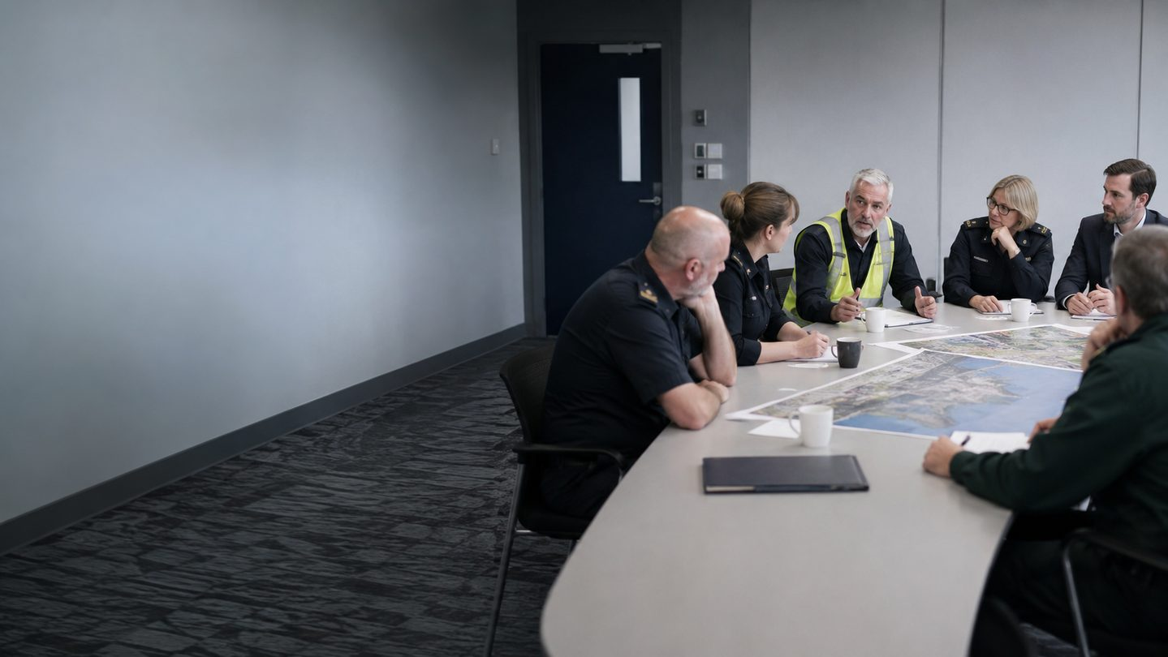
Committees must convert insight into action
Priority • Decision • Owner • Deadline • Evidence
A multi-agency meeting adds value when it resolves dependencies and records accountable commitments.
Track overdue actions and escalate unresolved shared risk.
Notes:
Use the image to explore human, organisational and operational dependencies.
[Sources]
- London Gateway College, Port Security Management (PSM-28), supplied course source.
- Image: AI-generated specifically for this learning aid.
[/Sources]

Slide 22
PORT SECURITY MANAGEMENT • PSM-28 • LECTURE 13
Security committee design
MANDATE
OPERATING RHYTHM
Defined purpose, authority, membership and reporting line
Threat, incident, performance and change agenda
Avoid meeting without power
DECISION RECORD — Owner, due date, evidence and escalation
22
Notes:
Explain the framework, apply it to a familiar port process and identify evidence of effective implementation.
[Sources]
- London Gateway College, Port Security Management (PSM-28), supplied course source.
- https://www.imo.org/en/ourwork/security/pages/solas-xi-2%20isps%20code.aspx
- https://www.gov.uk/guidance/maritime-security
- https://www.legislation.gov.uk/uksi/2009/2048
- https://www.imo.org/en/OurWork/Security/Pages/Whole-of-Government-Approach-to-Maritime-Security.aspx
- https://ico.org.uk/for-organisations/uk-gdpr-guidance-and-resources/
[/Sources]

Slide 23
PORT SECURITY MANAGEMENT • PSM-28 • LECTURE 13
The challenge of collaboration
Barriers should be managed openly rather than hidden behind general agreement.
AUTHORITY
INFORMATION
Different powers and accountabilities
Classification, privacy and source protection
PRIORITY
CULTURE
Competing missions, demand and timescales
Language, trust and risk tolerance
Use protocols • liaison roles • exercises • decision logs • senior escalation
23
Notes:
Explain the framework, apply it to a familiar port process and identify evidence of effective implementation.
[Sources]
- London Gateway College, Port Security Management (PSM-28), supplied course source.
- https://www.imo.org/en/ourwork/security/pages/solas-xi-2%20isps%20code.aspx
- https://www.gov.uk/guidance/maritime-security
- https://www.legislation.gov.uk/uksi/2009/2048
- https://www.imo.org/en/OurWork/Security/Pages/Whole-of-Government-Approach-to-Maritime-Security.aspx
- https://ico.org.uk/for-organisations/uk-gdpr-guidance-and-resources/
[/Sources]

Slide 24
PORT SECURITY MANAGEMENT • PSM-28 • LECTURE 13
Management assurance dashboard
Use a small set of measures that reveal control reliability and emerging risk.
READINESS
Critical posts, systems and contacts available
CONTROL
Access, patrol, cargo and monitoring performance
RESPONSE
Notification, attendance and decision time
PARTNERS
Exercise actions and shared risks
IMPROVEMENT
Defects, owners, overdue and retest
Pair indicators with professional judgement and qualitative evidence.
24
Notes:
Explain the framework, apply it to a familiar port process and identify evidence of effective implementation.
[Sources]
- London Gateway College, Port Security Management (PSM-28), supplied course source.
- https://www.imo.org/en/ourwork/security/pages/solas-xi-2%20isps%20code.aspx
- https://www.gov.uk/guidance/maritime-security
- https://www.legislation.gov.uk/uksi/2009/2048
- https://www.imo.org/en/OurWork/Security/Pages/Whole-of-Government-Approach-to-Maritime-Security.aspx
- https://ico.org.uk/for-organisations/uk-gdpr-guidance-and-resources/
[/Sources]

Slide 25
PORT SECURITY MANAGEMENT • PSM-28 • LECTURE 13
Applied scenario: protest and threat report
A planned protest coincides with an anonymous threat, a high-profile vessel call and constrained police resources.
GOVERN
COORDINATE
OPERATE
ASSURE
Who sets priorities and accepts risk?
Which responsibilities remain with each partner?
How will lawful protest and secure operations coexist?
What evidence triggers escalation or stand-down?
Record assumptions, options, decision owner and review time.
25
Notes:
Facilitate the applied scenario using approved escalation routes, clear ownership and a review trigger.
[Sources]
- London Gateway College, Port Security Management (PSM-28), supplied course source.
- https://www.imo.org/en/ourwork/security/pages/solas-xi-2%20isps%20code.aspx
- https://www.gov.uk/guidance/maritime-security
- https://www.legislation.gov.uk/uksi/2009/2048
- https://www.imo.org/en/OurWork/Security/Pages/Whole-of-Government-Approach-to-Maritime-Security.aspx
- https://ico.org.uk/for-organisations/uk-gdpr-guidance-and-resources/
[/Sources]

Slide 26
PORT SECURITY MANAGEMENT • PSM-28 • LECTURE 13
Knowledge check
Which statement best reflects effective port-security management?
Law-enforcement presence transfers responsibility for facility security to the police.
Effective management aligns governance, lawful roles, resources, operations, collaboration and assurance around priority risk.
Committees are effective when they meet frequently, regardless of action closure.
Compliance evidence removes the need to measure operational performance.
Choose one answer and identify two governance controls.
26
Notes:
Correct answer: B. Ask learners to explain why each distractor is weaker.
[Sources]
- London Gateway College, Port Security Management (PSM-28), supplied course source.
- https://www.imo.org/en/ourwork/security/pages/solas-xi-2%20isps%20code.aspx
- https://www.gov.uk/guidance/maritime-security
- https://www.legislation.gov.uk/uksi/2009/2048
- https://www.imo.org/en/OurWork/Security/Pages/Whole-of-Government-Approach-to-Maritime-Security.aspx
- https://ico.org.uk/for-organisations/uk-gdpr-guidance-and-resources/
[/Sources]

Slide 27
PORT SECURITY MANAGEMENT • PSM-28 • LECTURE 13
Lecture 13: key takeaways
Clear authority, accountability and interfaces make security dependable.
Port security and law enforcement contribute different but complementary capabilities.
Suspicious activity requires behavioural observation, proportionate action and evidence preservation.
Resources and regulatory duties must be translated into usable operational controls.
Partnerships need protocols, exercises, decisions and verified action closure.
Next lecture: Integrated Port Security Management — Capstone and Course Review
27
Notes:
Ask each learner to identify one action they will transfer into practice.
[Sources]
- London Gateway College, Port Security Management (PSM-28), supplied course source.
[/Sources]

Slide 28
PORT SECURITY MANAGEMENT • PSM-28 • LECTURE 13
References and further learning
London Gateway College. Port Security Management (PSM-28), Lecture 13: Effective Management for Securing Port Facilities.
International Maritime Organization — SOLAS Chapter XI-2 and ISPS Code
UK Government — Maritime security guidance
The Port Security Regulations 2009
IMO — Whole-of-Government Approach to Maritime Security
Information Commissioner's Office — UK GDPR guidance
Apply current UK law, approved plans, competent-authority directions and locally agreed multi-agency protocols.
28
Notes:
Direct learners to current official guidance, approved local plans and competent-authority instructions.
[Sources]
- London Gateway College, Port Security Management (PSM-28), supplied course source.
- https://www.imo.org/en/ourwork/security/pages/solas-xi-2%20isps%20code.aspx
- https://www.gov.uk/guidance/maritime-security
- https://www.legislation.gov.uk/uksi/2009/2048
- https://www.imo.org/en/OurWork/Security/Pages/Whole-of-Government-Approach-to-Maritime-Security.aspx
- https://ico.org.uk/for-organisations/uk-gdpr-guidance-and-resources/
[/Sources]

