Slide 1
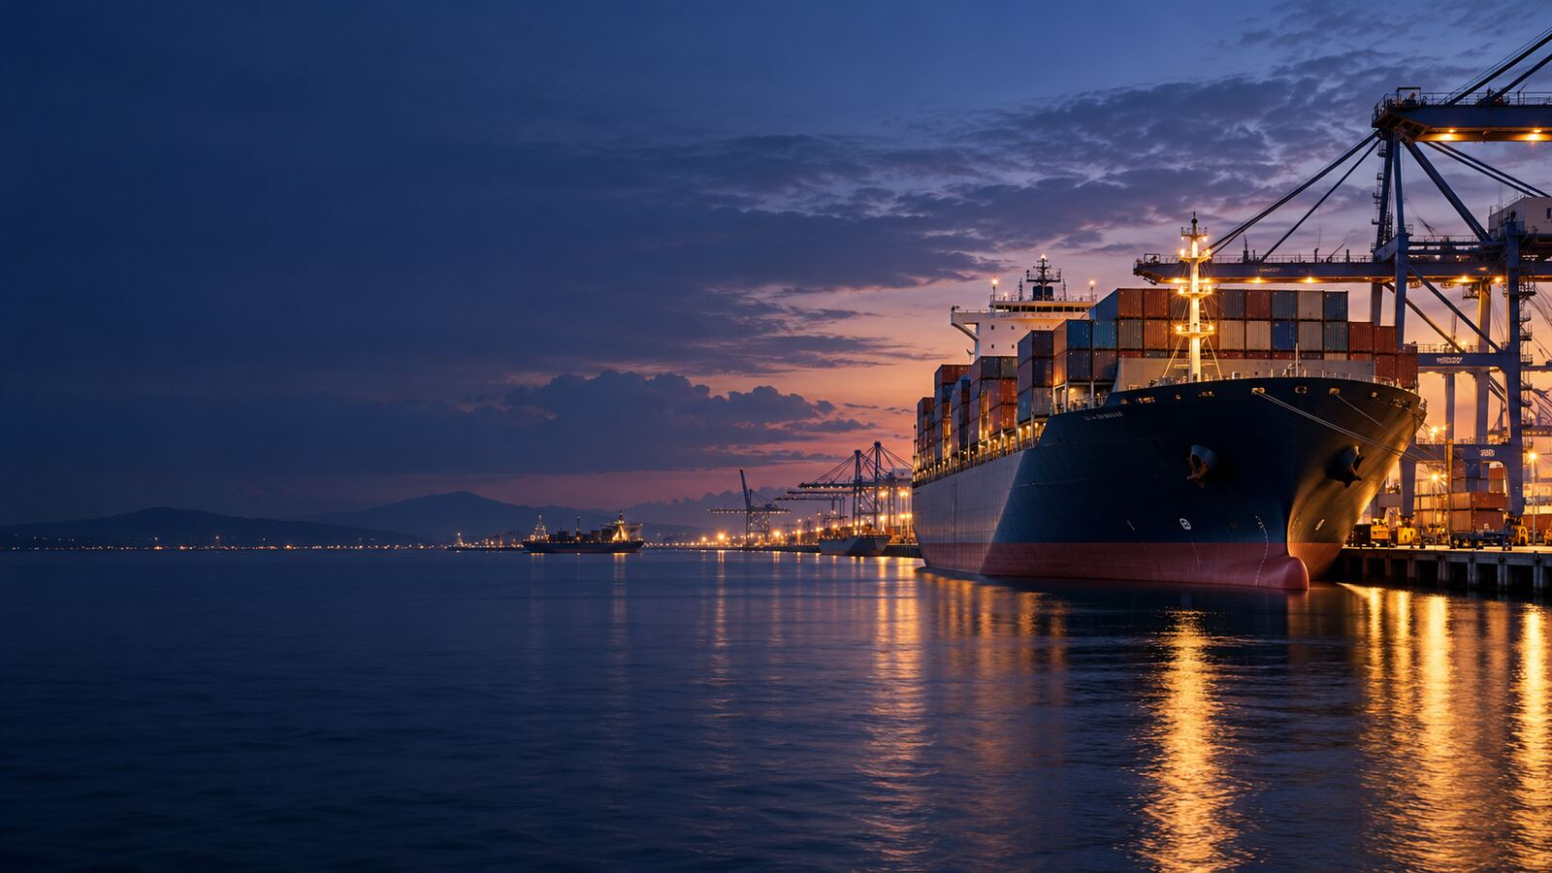

LONDON GATEWAY COLLEGE
LECTURE 9
SAFE PORTS CLAIMS
Compendium of Maritime Claims
Course Code LGC450
Notes:
Source: London Gateway College supplied course material, Compendium of Maritime Claims (LGC450). LECTURE 9. Educational use only.

Slide 2
LONDON GATEWAY COLLEGE
LGC450
Learning focus
• Explain the principal concepts associated with safe ports claims.
• Apply the lecture principles to a realistic professional situation.
• Identify the evidence, authority and judgement required for a defensible conclusion.
• INTRODUCTION
• DEFINING SAFE PORT
• SAFE BERTHS
Compendium of Maritime Claims 02
Notes:
Source: London Gateway College supplied course material, Compendium of Maritime Claims (LGC450). Learning focus. Educational use only.

Slide 3
LONDON GATEWAY COLLEGE
LGC450
INTRODUCTION
• The majority of contracts of carriage, encompassing charterparties, bills of lading, sea waybills, and similar documents, typically incorporate provisions that delineate the permissible trading areas for vessels.
• The reason is because during the operational lifespan of ships, she routinely navigates diverse ports, docks, anchorages, and offshore locations which can pose danger to the ship.
• Even though some of the perils and hazards that the ship can face are unforeseen, it may lead to minor as well as catastrophic losses.
• These hazards, often latent or unexpected, can emanate from the visited location itself.
Compendium of Maritime Claims 03
Notes:
Source: London Gateway College supplied course material, Compendium of Maritime Claims (LGC450). INTRODUCTION. Educational use only.

Slide 4
LONDON GATEWAY COLLEGE
LGC450
DEFINING SAFE PORT
• The concept of a "safe" port has been eloquently articulated by the English High Court in The Eastern City, offering guidance on what constitutes a safe haven for maritime activities which stated as follows: “A port will not.
• The port's safety assessment is intimately linked to the unique characteristics of the vessel in question.
• A port may be secure for certain ships but perilous for others due to differences in size, draft, beam, and other attributes.
• The fact that many ships have safely used the port does not conclusively establish its safety, as these vessels might possess distinct characteristics.
Compendium of Maritime Claims 04
Notes:
Source: London Gateway College supplied course material, Compendium of Maritime Claims (LGC450). DEFINING SAFE PORT. Educational use only.

Slide 5
LONDON GATEWAY COLLEGE
LGC450
SAFE BERTHS
• Sometimes, a contract may stipulate that the ship must head to a berth rather than just a port.
• In such cases, the general principles outlined earlier concerning safe ports typically apply to the berth as well.
• Hence, if the contract specifies that the vessel should load at a berth nominated by the charterers within a named port without explicitly stating that either the port or the berth must be 'safe', then, unless the nominated.
• However, if the charter explicitly includes a safety provision for the berth, then, the charterers commit to ensuring the nominated berth(s) are safe.
Compendium of Maritime Claims 05
Notes:
Source: London Gateway College supplied course material, Compendium of Maritime Claims (LGC450). SAFE BERTHS. Educational use only.

Slide 6
LONDON GATEWAY COLLEGE
LGC450
THE SHIPOWNERS’ REMEDIES
• When a ship is directed by charterers to an unsafe port or berth, two distinct issues arise:
• Can the shipowner be compelled to proceed to that port or berth?
• Can the shipowner seek damages for losses or damages incurred due to entering such a port or berth or reasonably refusing to do so?
• Can the Shipowners be compelled to proceed to that Port or Berth?
Compendium of Maritime Claims 06
Notes:
Source: London Gateway College supplied course material, Compendium of Maritime Claims (LGC450). THE SHIPOWNERS’ REMEDIES. Educational use only.

Slide 7
LONDON GATEWAY COLLEGE
LGC450
LIMITATION AND STRICT LIABILITY
• The liability of charterers for sending a vessel to an unsafe port is often strict, potentially leading to significant damages, including damage or loss of the ship and cargo, pollution liabilities reimbursement, and more.
• To mitigate this liability, charterers may seek to limit their liability claims.
• To qualify for such a limitation, one must prove they are a "person entitled to limit" for the specific claim in question.
• Regarding insurance, Hull and Machinery insurance typically covers physical damage to the ship resulting from entering an unsafe port, but it does not cover losses due to delays in avoiding or entering such places.
Compendium of Maritime Claims 07
Notes:
Source: London Gateway College supplied course material, Compendium of Maritime Claims (LGC450). LIMITATION AND STRICT LIABILITY. Educational use only.

Slide 8
LONDON GATEWAY COLLEGE
LGC450
Applied activity
• Review a fictional or public scenario involving safe ports claims.
• Identify the material facts, unresolved assumptions and governing principles.
• Prepare an issue and evidence matrix before reaching a conclusion.
• Recommend practical action and explain any point requiring specialist advice.
Compendium of Maritime Claims 08
Notes:
Source: London Gateway College supplied course material, Compendium of Maritime Claims (LGC450). Applied activity. Educational use only.

Slide 9
LONDON GATEWAY COLLEGE
LGC450
Knowledge check
• What is the central principle examined in safe ports claims?
• Which facts would materially change the analysis?
• Which source provides the strongest authority for your conclusion?
• What evidence should a professional obtain first?
• Which risk, remedy or control should receive priority, and why?
Compendium of Maritime Claims 09
Notes:
Source: London Gateway College supplied course material, Compendium of Maritime Claims (LGC450). Knowledge check. Educational use only.

Slide 10
LONDON GATEWAY COLLEGE
LGC450
Independent research task
• Consult at least two authoritative sources listed in the lecture learning guide.
• Prepare a 900 to 1,100 word professional response and a one-page issue or evidence matrix.
• Cite every external source and record the date accessed.
• Upload the final work, source list and originality declaration to the LMS.
Compendium of Maritime Claims 10
Notes:
Source: London Gateway College supplied course material, Compendium of Maritime Claims (LGC450). Independent research task. Educational use only.

Slide 11
LONDON GATEWAY COLLEGE
LGC450
Lecture summary
• INTRODUCTION
• DEFINING SAFE PORT
• SAFE BERTHS
• THE SHIPOWNERS’ REMEDIES
• LIMITATION AND STRICT LIABILITY
Compendium of Maritime Claims 11
Notes:
Source: London Gateway College supplied course material, Compendium of Maritime Claims (LGC450). Lecture summary. Educational use only.

Slide 12
LONDON GATEWAY COLLEGE
LGC450
Recommended sources
• Marine Insurance Act 1906
• Merchant Shipping Act 1995
• IMO list of maritime conventions
• Civil Procedure Rules Part 61 Admiralty Claims
• London Gateway College Compendium of Maritime Claims course material
Compendium of Maritime Claims 12
Notes:
Source: London Gateway College supplied course material, Compendium of Maritime Claims (LGC450). Recommended sources. Educational use only.

