Slide 1
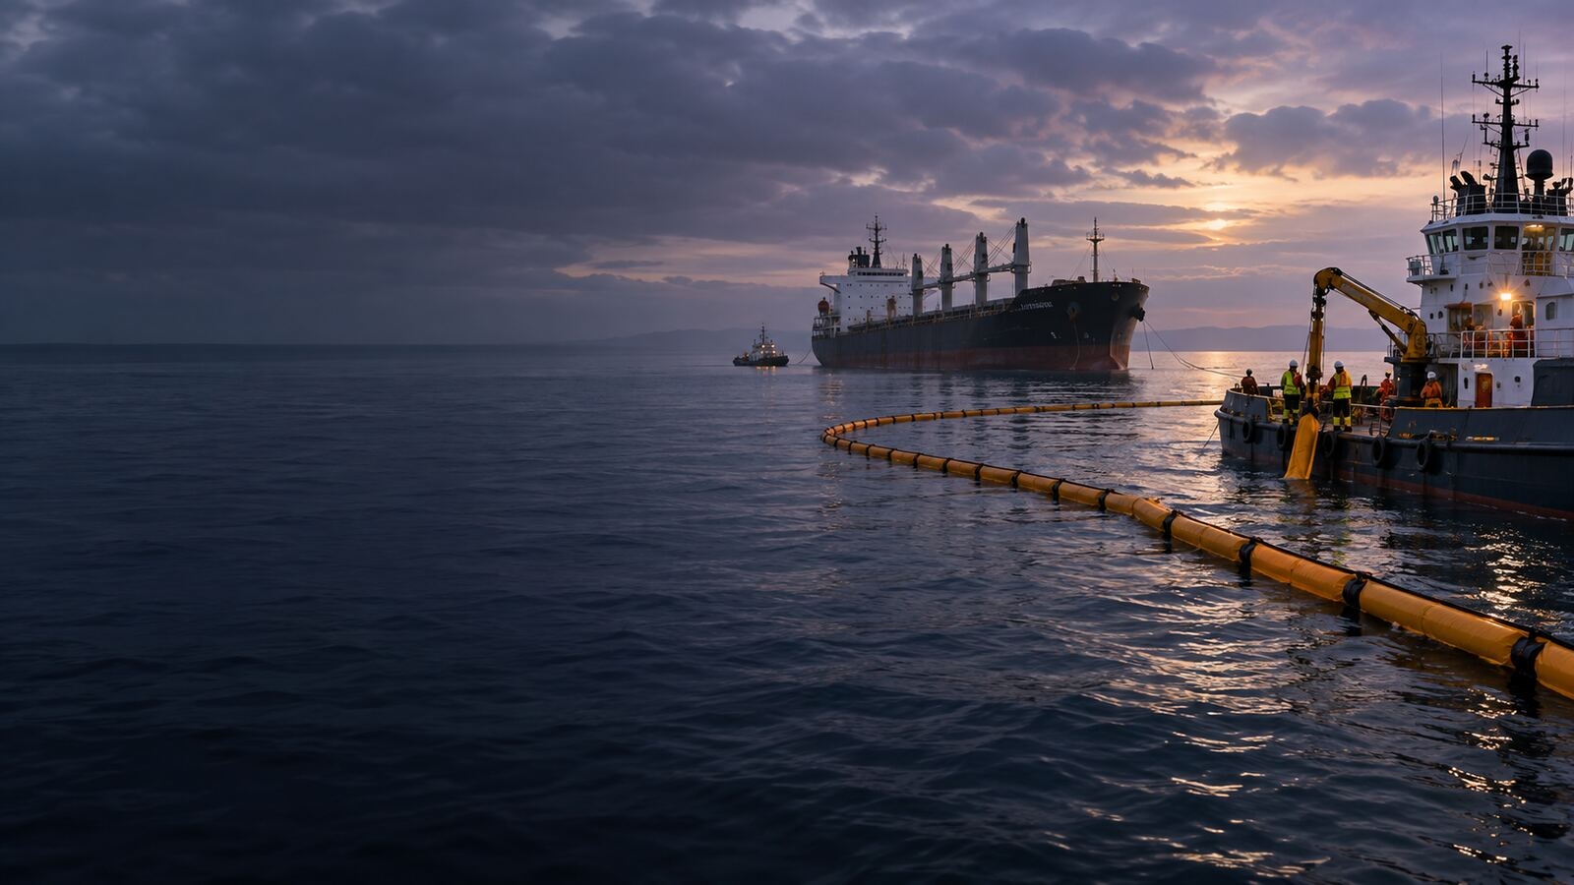

LONDON GATEWAY COLLEGE
STUDENT ORIENTATION
COURSE INTRODUCTION
Oil Pollution and Compensation Law
Course Code LGC300
Notes:
Source: London Gateway College supplied course material, Oil Pollution and Compensation Law (LGC300). STUDENT ORIENTATION. Educational use only.

Slide 2
LONDON GATEWAY COLLEGE
LGC300
Course aim
• Develop the ability to understand and apply the legal, regulatory, financial and professional principles covered in Oil Pollution and Compensation Law.
• Use authoritative sources to analyse realistic maritime or commercial situations.
• Create clear evidence of independent learning, practical application and reflection.
Oil Pollution and Compensation Law 02
Notes:
Source: London Gateway College supplied course material, Oil Pollution and Compensation Law (LGC300). Course aim. Educational use only.

Slide 3
LONDON GATEWAY COLLEGE
LGC300
Course learning outcomes
• Identify and explain the key international conventions related to oil pollution, including MARPOL, the Civil Liability Convention and the Fund Convention.
• Analyse legal principles of liability and compensation for oil-pollution damage.
• Evaluate the effectiveness of current legal and institutional frameworks.
Oil Pollution and Compensation Law 03
Notes:
Source: London Gateway College supplied course material, Oil Pollution and Compensation Law (LGC300). Course learning outcomes. Educational use only.

Slide 4
LONDON GATEWAY COLLEGE
LGC300
Course learning outcomes continued
• Apply relevant legal concepts to case studies involving oil-pollution incidents.
• Demonstrate awareness of developments and challenges in oil-pollution law and enforcement.
Oil Pollution and Compensation Law 04
Notes:
Source: London Gateway College supplied course material, Oil Pollution and Compensation Law (LGC300). Course learning outcomes continued. Educational use only.

Slide 5
LONDON GATEWAY COLLEGE
LGC300
Course pathway
• 1. Compensation for Pollution Damage from Seabed Mineral Exploration and Extraction
• 2. OIL POLLUTION CLAIMS AND PUBLIC NUISANCE
• 3. LEGAL PRECEDENTS AND THE EVOLUTION OF PUBLIC NUISANCE
• 4. THE RECOVERABILITY OF PURE ECONOMIC LOSS IN PUBLIC NUISANCE
• 5. DETERMINING WHETHER DAMAGE IS DIRECT OR MERELY CONSEQUENTIAL
Oil Pollution and Compensation Law 05
Notes:
Source: London Gateway College supplied course material, Oil Pollution and Compensation Law (LGC300). Course pathway. Educational use only.

Slide 6
LONDON GATEWAY COLLEGE
LGC300
Independent learning pathway
• Study each lecture presentation and record initial questions.
• Complete the directed reading and identify relevant authority.
• Undertake the lecture research and practical activity.
• Upload the required evidence and complete the knowledge check.
• Respond to feedback and retain the final version in the learner portfolio.
Oil Pollution and Compensation Law 06
Notes:
Source: London Gateway College supplied course material, Oil Pollution and Compensation Law (LGC300). Independent learning pathway. Educational use only.

Slide 7
LONDON GATEWAY COLLEGE
LGC300
Assessment and completion
• Complete every required lecture activity and retain evidence in the learner portfolio.
• Complete the final online assessment within the recommended three hours.
• The final assessment carries 100 marks and requires a minimum score of 70%.
• A reassessment opportunity may follow feedback or remedial learning where the required standard is not achieved.
Oil Pollution and Compensation Law 07
Notes:
Source: London Gateway College supplied course material, Oil Pollution and Compensation Law (LGC300). Assessment and completion. Educational use only.

