Slide 1
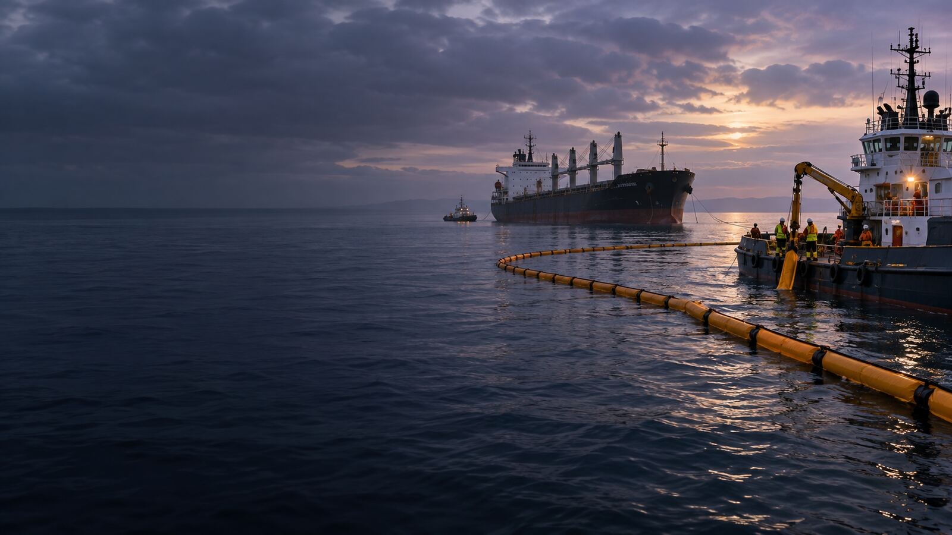

LONDON GATEWAY COLLEGE
LEARNER PORTFOLIO
COURSE CONCLUSION
Oil Pollution and Compensation Law
Course Code LGC300
Notes:
Source: London Gateway College supplied course material, Oil Pollution and Compensation Law (LGC300). LEARNER PORTFOLIO. Educational use only.

Slide 2
LONDON GATEWAY COLLEGE
LGC300
Course review
• Review the evidence produced across all 5 lectures.
• Confirm that each activity demonstrates research, application and professional judgement.
• Check that every source is traceable and every required correction has been completed.
Oil Pollution and Compensation Law 02
Notes:
Source: London Gateway College supplied course material, Oil Pollution and Compensation Law (LGC300). Course review. Educational use only.

Slide 3
LONDON GATEWAY COLLEGE
LGC300
Portfolio evidence
• Lecture activity submissions and issue or evidence matrices.
• Completed knowledge checks and recorded results.
• Research notes, source extracts and citation records.
• Tutor feedback, corrections and resubmitted work where required.
• Final reflection and learner declaration.
Oil Pollution and Compensation Law 03
Notes:
Source: London Gateway College supplied course material, Oil Pollution and Compensation Law (LGC300). Portfolio evidence. Educational use only.

Slide 4
LONDON GATEWAY COLLEGE
LGC300
Final reflection
• Which three submissions best demonstrate your development?
• Which principle or assumption changed most during the course?
• Where do you still require further reading or specialist support?
• What professional action will you take within 30 days?
Oil Pollution and Compensation Law 04
Notes:
Source: London Gateway College supplied course material, Oil Pollution and Compensation Law (LGC300). Final reflection. Educational use only.

Slide 5
LONDON GATEWAY COLLEGE
LGC300
Final assessment
• Three-hour online assessment.
• Section A contains 20 multiple-choice questions worth 40 marks.
• Section B contains five short-answer questions worth 30 marks.
• Section C contains one practical case study worth 30 marks.
• The minimum CPD assessment requirement is 70%.
Oil Pollution and Compensation Law 05
Notes:
Source: London Gateway College supplied course material, Oil Pollution and Compensation Law (LGC300). Final assessment. Educational use only.

Slide 6
LONDON GATEWAY COLLEGE
LGC300
Completion and certification
• Confirm that all required learning activities are complete.
• Submit the learner portfolio and final assessment in the approved format.
• Retain feedback, results and the course-completion record.
• Certificate eligibility depends on completion of the learning pathway and achievement of the approved assessment standard.
Oil Pollution and Compensation Law 06
Notes:
Source: London Gateway College supplied course material, Oil Pollution and Compensation Law (LGC300). Completion and certification. Educational use only.

